Slide 1
Neutron clustering in Monte Carlo power iteration Andrea Zoia (CEA/Saclay) Eric Dumonteil (IRSN)
NEA EGAMCT meeting|
Andrea ZOIA| DEN/DANS/DM2S/SERMA/LTSD
June 28th 2017

Slide 2
Outline
Power iteration with Monte Carlo
The impact of clustering in criticality simulations
Perspectives

Slide 3
The Critical boltzmann equation
We would like to determine
the fundamental mode ϕ₁
and the associated fundamental eigenvalue k₁ of
Critical Boltzmann equation for the neutron flux ϕ
Net disappearance operator L
Creation (fission) operator F

Slide 4
Power iteration
A generalized eigenvalue equation
Power iteration algorithm:
Guess solution
Iterate
Hypothesis
Convergence

Slide 5
Monte Carlo approach: criticality simulation
1st gen.
2nd gen.
3rd gen.
4th gen.
5th gen.
Fission chain
Source
t
Source
1st gen.
2nd gen.
3rd gen.
N₀ particles
Fission generations

Slide 6
power iteration: The standard (?) tool
Source
1st gen.
…
G^{th} gen.
(G+1)^{th} gen.
…
Mth gen.
N₀ particles
…
Convergence to the fundamental mode ϕ₁
(statistical equilibrium)
Stationarity: sample ϕ₁
at each generation
Hypothesis: (I)ID replicas
What about correlations ?
Kaplan, UCRL-5275-T (1958)
Goad and Johnston, NSE 5, 371-375 (1959)

Slide 7
Ensemble averages vs. averages over generations
S₁
D
X₁
Independent replicas and ensemble averages
…
S_{i}
D
X_{i}
…
Inactive cycles: D x M
S_{M}
D
X_{M}
Convergence
S
D
X₁
X₂
…
X_{M-1}
X_{M}
Power iteration
Inactive cycles: D

Slide 8
A Toy model of a nuclear reactor
Neutrons in a box
Scattering
Capture
Fission
Descendants per fission
Reflecting boundary conditions
Assumption:
the reactor is critical
Expected fundamental mode ϕ₁: spatially uniform over the box

Slide 9
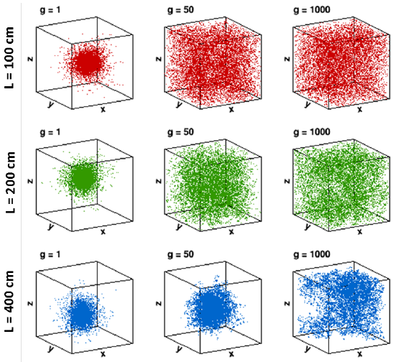
Impact of system size L on power iteration
Generations
Delta-like source at the center of the box
Initial number of neutrons per generation N = 10⁴

Slide 10
Impact of system size L on power iteration
Neutrons per generation N = 10⁴
Neutron clustering

Slide 11
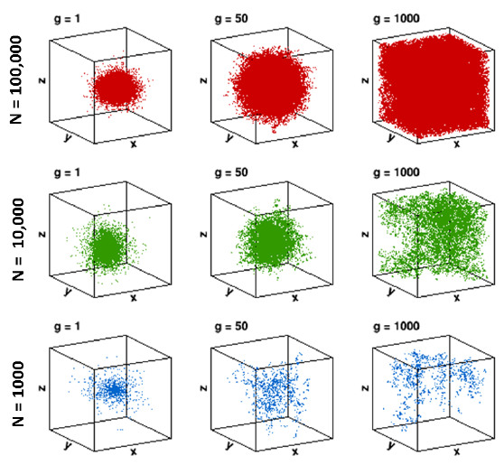
Impact of population size N on power iteration
Generations
Delta-like source at the center of the box
System size L = 400 cm

Slide 12
Impact of population size N on power iteration
N
System size L = 400 cm
Neutron clustering

Slide 13
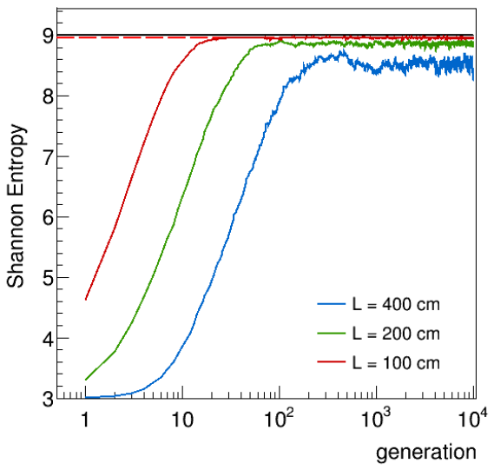
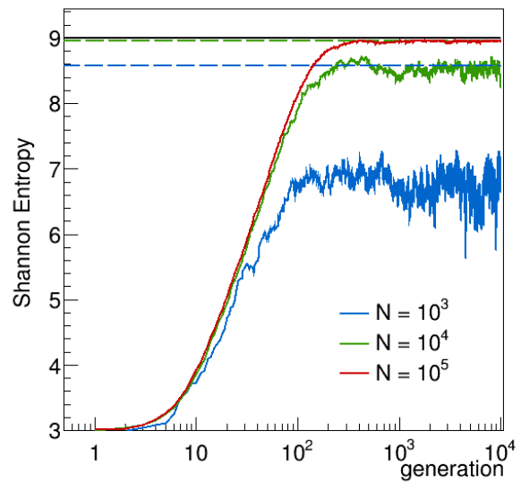
the entropy function: convergence analysis
m
Shannon entropy:
m
Generations to convergence:

Slide 14
aN “apparent” statistical equilibrium
Shannon entropy:
Theoretical expected value for independent replicas
Measured value
for power iteration
Impact of clustering on the equilibrium

Slide 15
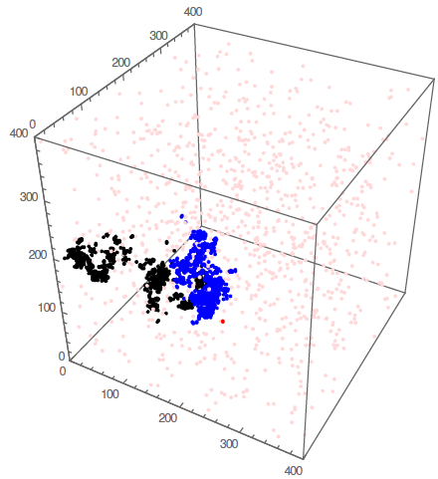
Starting from the equilibrium configuration
Source: uniform distribution
(i.e., fundamental eigen-mode)
System size L = 400 cm, N=10³
Blue dots: after 10² generations Black: after 10³ generations
Statistically stationary
but highly clustered distribution
Fig. taken from
T. Sutton, M&C2017

Slide 16
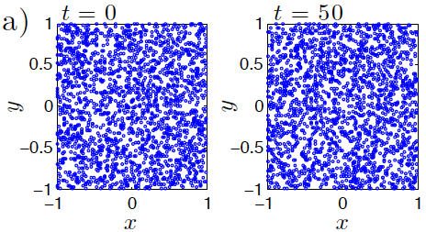
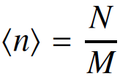
Occupation of spatial sites
Fluctuations:
M spatial meshes of size L³ / M
Generation 1
Maxwell-Boltzmann distribution
Initial condition: N particles with uniform density
Probability R of having exactly s empty cells:

Slide 17
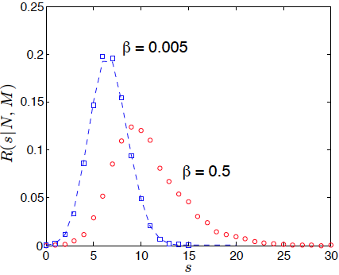
Occupation of spatial sites
M spatial meshes of size L³ / M
Probability R of having exactly s empty cells:
Generation 1000
Generation 1
Generation 10³
Highly non-Poissonian fluctuations
Maxwell-Boltzmann pdf
does not apply

Slide 18
Reciprocity of random walks
Forward time flow
Backward time flow
Measure in z
Measure in z
t
t
z
z
Source
Source
Boltzmann equation
Pal & Bell equations
Strategy:
Solve the backward Pal & Bell equations in continuous time
Convert time into discrete generations
Determine the neutron density ψ(x) and the correlation function h(x,y)

Slide 19
Spatial moments of The homogeneous cube reactor
Average neutron density:
Pair correlation function:
System size L
Single dimensionless parameter
Migration area M²
Population size N

Slide 20
Power iteration as a function of ξ
Generation 1
Uniform initial condition

Slide 21
Power iteration as a function of ξ
g = 1
g = 10²
g = 10³
Bounded fluctuations:

Slide 22
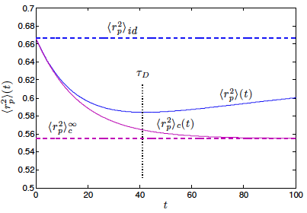
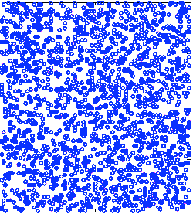
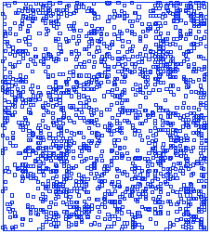
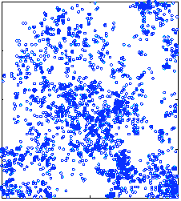
Analysis of Spatial moments
Average square distance between particle pairs:
Independent replicas
Uniform source
Power iteration

Slide 23
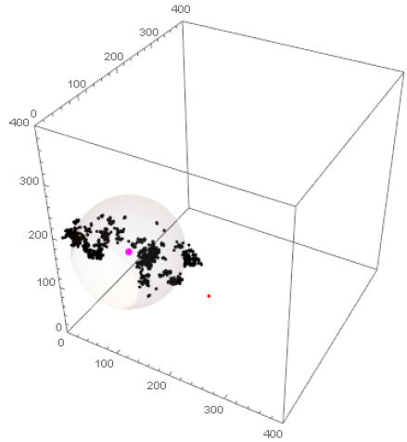
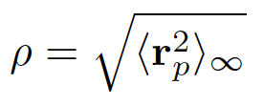
Spatial localisation of the dominant cluster
Localisation radius
Source: uniform distribution
(i.e., fundamental eigen-function)
System size L = 400 cm, N=10³
Black: after 10³ generations
Average square distance between particle pairs:
Fig. taken from
T. Sutton, M&C2017

Slide 24
What’s the course, helmsman ?
Diagnostic tools for clustering in power iteration
Impact of boundary conditions
Heterogeneous configurations
Ergodic theory and bias on the spatial tallies

Slide 25
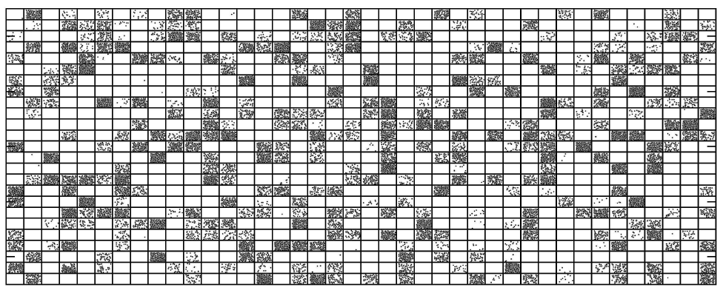
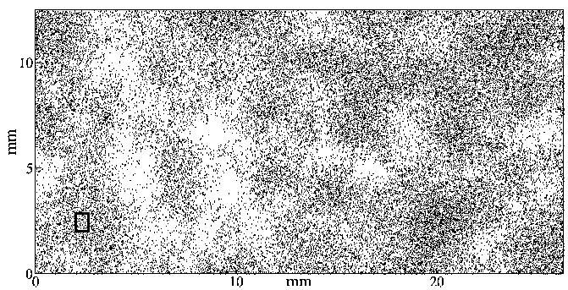
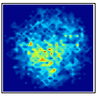
Clustering: past and future
First works on clustering: theoretical ecology (Cox & Griffeath, 1980)
Fluctuations of individuals subject to diffusion, reproduction and death
Monte Carlo simulations
Experiments
Houchmandzadeh & Vallade (2009)
Neutron clustering in reactor physics (Dumonteil et al., 2013)
Monte Carlo simulations
Experiments

Slide 26
Thanks for your attention
E. Dumonteil, F. Malvagi, A. Zoia, A. Mazzolo, D. Artusio, C. Dieudonné, C. de Mulatier, Proceedings of SNA+MC2013, Paris, France.
E. Dumonteil, F. Malvagi, A. Zoia, A. Mazzolo, D. Artusio, C. Dieudonné, C. de Mulatier, Ann. Nucl. Energy 63, 612-618 (2014).
A. Zoia, E. Dumonteil, A. Mazzolo, C. de Mulatier, A. Rosso, Phys. Rev. E 90, 042118 (2014).
C. de Mulatier, E. Dumonteil, A. Rosso, A. Zoia, J. Stat. Mech. P08021 (2015).
B. Houchmandzadeh, E. Dumonteil, A. Mazzolo, A. Zoia, Phys. Rev. E 92, 052114 (2015).
M. Nowak, J. Miao, E. Dumonteil, B. Forget, A. Onillon, K. Smith, A. Zoia, Ann. Nucl. Energy 94 856-868 (2016).

Slide 27
DEN/DANS DM2S SERMA
Commissariat à l’énergie atomique et aux énergies alternatives
Centre de Saclay | 91191 Gif-sur-Yvette Cedex
T. +33 (0)1 69 08 62 75 | Secr :+33 (0)1 69 08 39 61
Etablissement public à caractère industriel et commercial | RCS Paris B 775 685 019

