Slide 1
www.decomconference.org
International Conference
«Decommissioning of nuclear facilities: Strategies, Practices and Challenges»
Results
09-11 November, 2015 Moscow, Centre of International Trade
Organiser:
With support:
Operator:

Slide 2
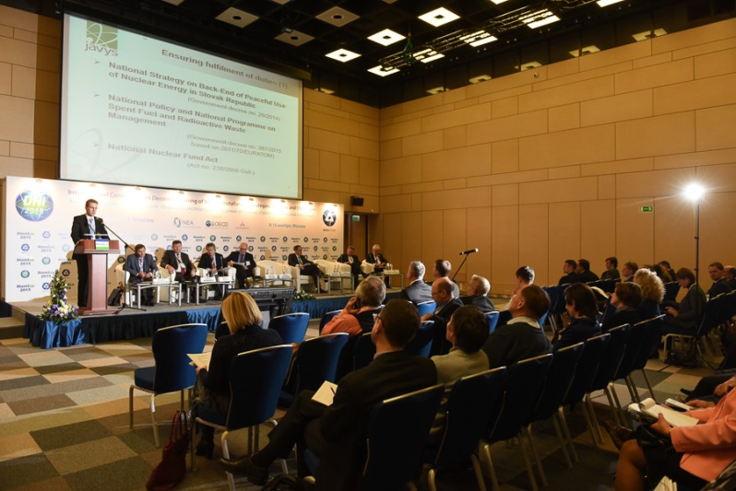
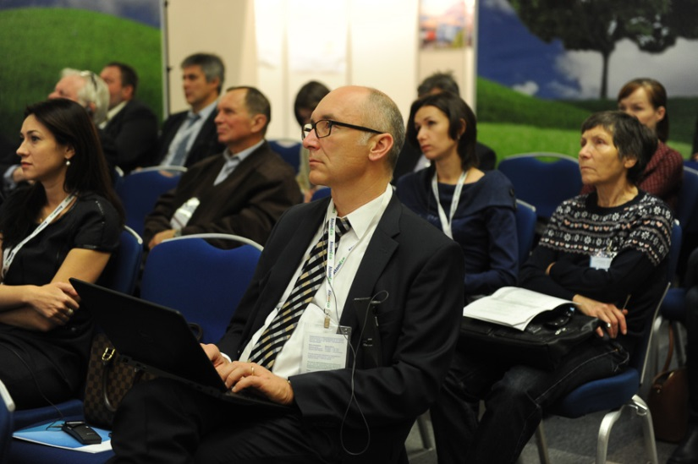
www.decomconference.org
-2-
About Conference
Statistics
Speakers - 25;
Participants – more than 100;
Countries-participants - 14 (Russia, Japan, US, Germany, France, Belgium, Sweden, Italy, UK, Slovak republic, Switzerland, Norway, Hungary, Czech republic); Media representatives – 68; Posters – till 10;
Technical tour – 1
From 9 till 10 November 2015, in the Centre of International Trade (Moscow), in the same time with VIII International Exhibition «ATMECO-2015», an International Conference «Decommissioning of Nuclear Facilities: strategies, practices and challenges», organised by the OECD NEA with Rosatom’s support firstly successfully took place.

Slide 3
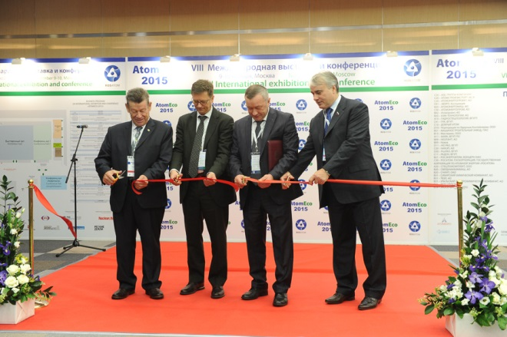
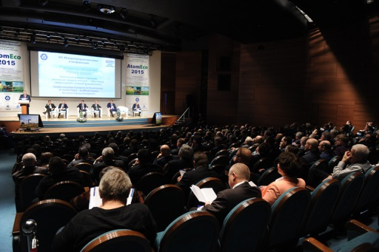
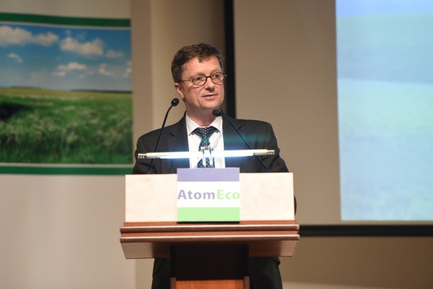
www.decomconference.org
-3-
Opening ceremony
In joint opening ceremony of “ATOMECO-2015” and International Conference on Decommissioning the head of division of Radiological Protection and Radioactive Waste Management (OECD NEA) Michael Siemann has take a part.
The Chair of Committee of State Duma on energy P. Zavalnyi, Director on State Policy on Radioactive Waste and Spent Fuel management and Decommissioning (Rosatom) O. Kryukov and adviser of Director General of State Corporation Rosatom, coordinator on realisation of ecological policy of Rosatom B. Grachev participated also and made speeches.
«Our Agency is delighted with the professional level demonstrated by Russian specialists.
I hope that NEA countries-participants will expand the cooperation with Russian Federation developing the joint approaches to decommissioning of nuclear facilities, radioactive waste management that is necessary for the development of nuclear energy industry» - M. Siemann said at the plenary session.

Slide 4
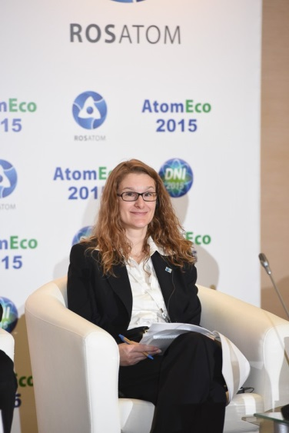
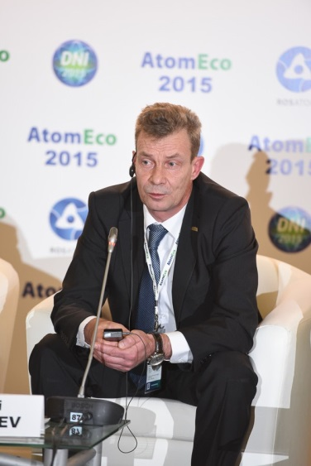
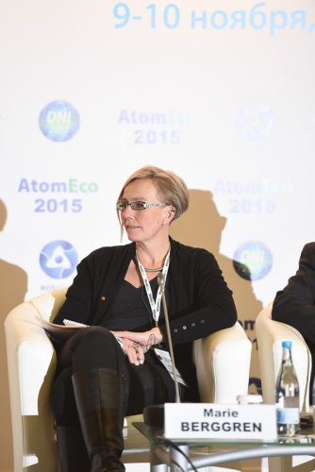
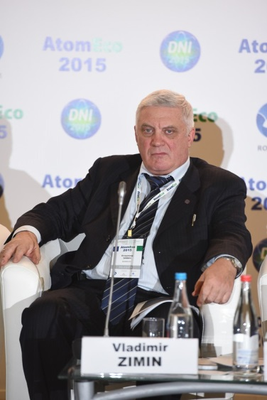
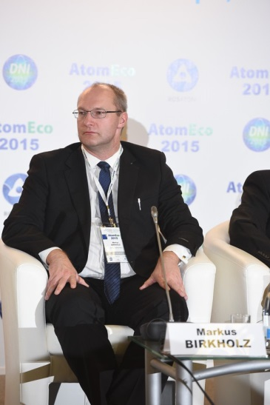
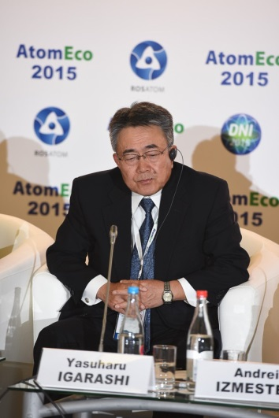
www.decomconference.org
Participants
Participants of the Conference were from:
companies working in decommissioning field under the Rosatom’s umbrella, private business, regulator, local community, radioactive waste management “National Operator” from Russia;
the OECD NEA,
foreign companies, organisations and local administrations as: JAPCO (Japan), ENSI (Switzerland), JAVYS (Slovak), EDF (France), NUKEM Technologies (Germany), NDA (UK), SOGIN (Italy), Belgoprocess (Belgium), M+W UK (UK), Östhammar municipality, (Sweden), SSM (Sweden) and others.

Slide 5
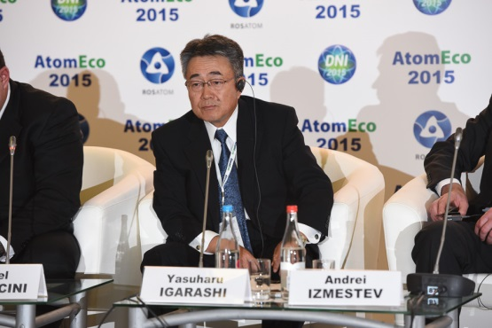
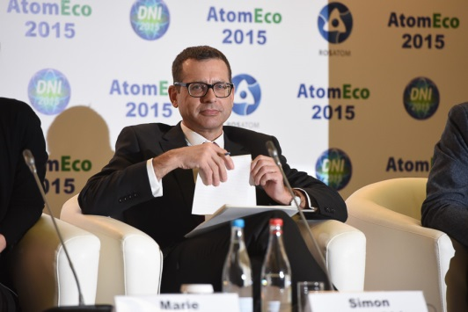
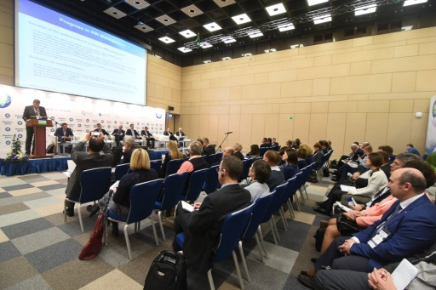
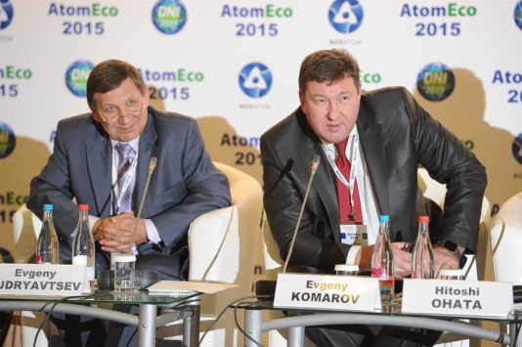
www.decomconference.org
-5-
Format of Conference
Conference was held in three open sessions:
«Governmental, Industrial and Business Strategies for the Decommissioning of Nuclear Power Plants»,
«Practical Experience and Future Challenges for the Decommissioning of Nuclear Facilities»,
«Different Roles and Expectations of Stakeholders in the Decommissioning Process».
Sessions participants discussed in details the main approaches to development of decommissioning strategies in Russia as well as best practices of other countries leading in the area of decommissioning and RW management. Also the involvement and roles of regulators, owners, authorities, staff and other stakeholders in the realisation of decommissioning projects.

Slide 6
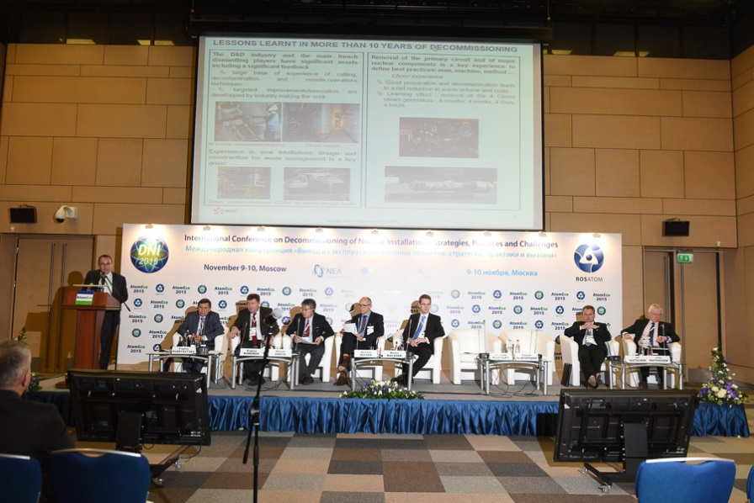
www.decomconference.org
-6-
Format of Conference
Session №1 «Governmental, Industrial and Business Strategies for the Decommissioning of Nuclear Power Plants»
Participants discussed strategic approaches in the world practice: main driving factors, decision making criteria from the different point of view of the national and international strategy developers, regulators, operators and service organisations.
Presentations were made by the representatives of State Corporation Rosatom, JAPCO (Japan), ENSI (Switzerland), JAVYS (Slovac), EDF (France), SOGIN (Italy), NUKEM Technologies (Germany) and NDA (UK).
Session №2 «Practical Experience and Future Challenges for the Decommissioning of Nuclear Facilities»
Practical aspects and approaches to decommissioning were presented by representatives of:
VNIIAES (Russia), NDF (Japan), Belgoprocess (Belgium), JSC “PDC UGR”, Russia, NUKEM Technologies Engineering Services GmbH (Germany), EWN (Germany), OECD NEA and AVERO (Russia)
Session №3 «Different Roles and Expectations of Stakeholders in the Decommissioning Process»
Session was focused on roles of the stakeholders of decommissioning, their concerns and challenges for them and main factors of success in solution of their problems in the presentations of:
Östhammar municipality (Sweden), SSM (Sweden),
MKG, Swedish NGO Office for
Nuclear Waste Review Environmental Organisation,
(Sweden), NO RAO (Russia), Rostechnadzor (Russia), PDC UGR (Russia) and Administration of Seversk.

Slide 7
www.decomconference.org
-7-
Discussions results
Discussions during sessions of Conference demonstrated a variety of understanding and approaches to the issues of decommissioning of nuclear facilities in different countries;
Some questions actively discussed at the sessions clearly noted their actuality (irradiated graphite management, preparation to decommissioning, regulation, etc.);
The definition of topics for sessions has appeared rather new and interesting for participants as they could to have a look on decommissioning from absolutely different point of view and to hear the opinion of main players and stakeholders from different countries;
Lively discussion has been after the third session where the anticipations and concerns of almost all kinds of stakeholders were presented (staff of the decommissioned facility, local administration/ community, regulator, RW management operator) in Russia and Sweden, that allowed comparing of approaches, discussion of experience and perspectives of decommissioning on the local level;
In spite of variety of the strategies, approaches and mechanisms of realisation the serious relation to the safety issues and efficiency of decommissioning were noted in all countries-participants.

Slide 8
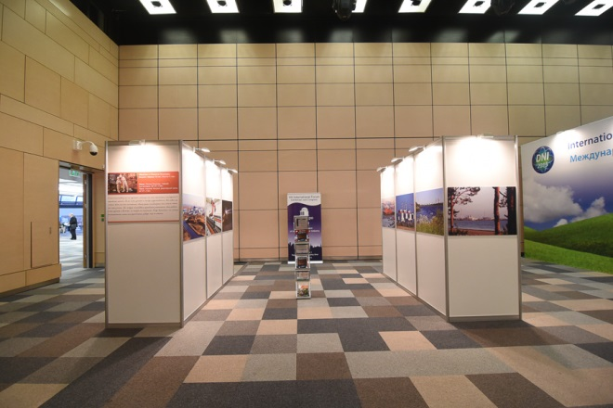
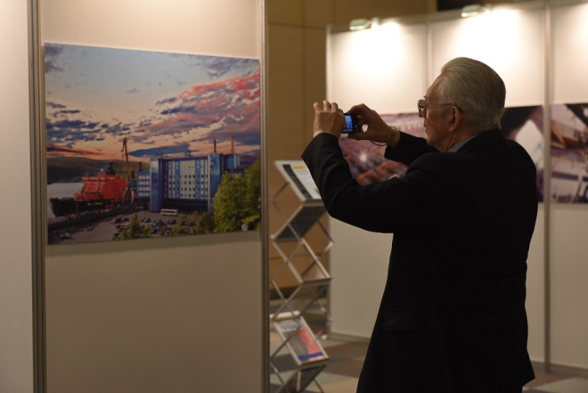
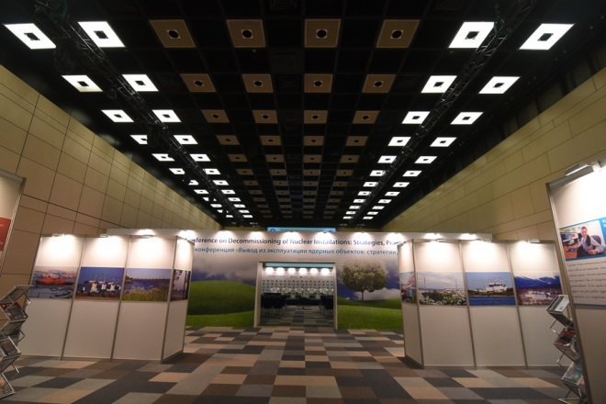
www.decomconference.org
-8-
Posters
Poster session was organised to demonstrate the results of work and achievements by the non-speakers and number of posters were presented.

Slide 9
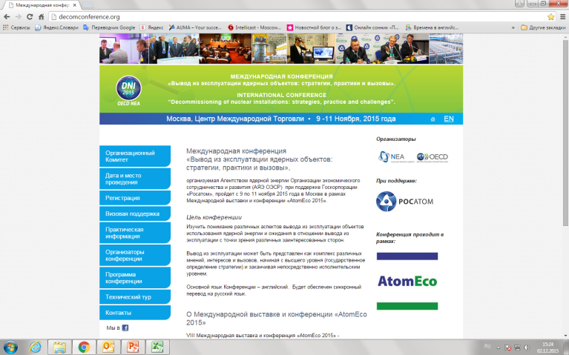
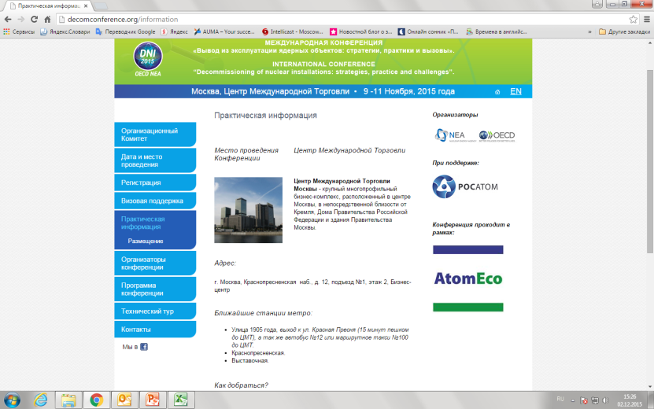
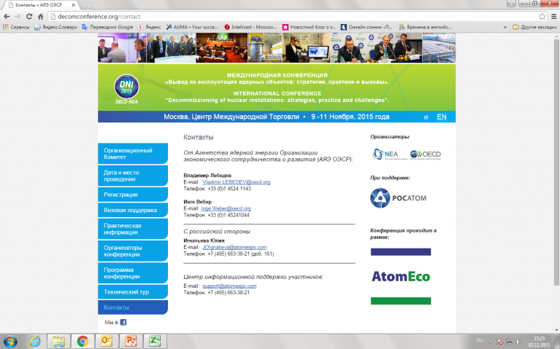
www.decomconference.org
-9-
Conference site - www.decomconference.org
Especially for the Conference the web page was created where participants could get the information needed, register for the Conference, book hotel, get visa supporting ask questions and many other options.

Slide 10
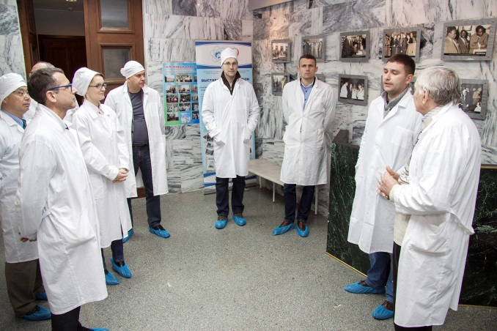
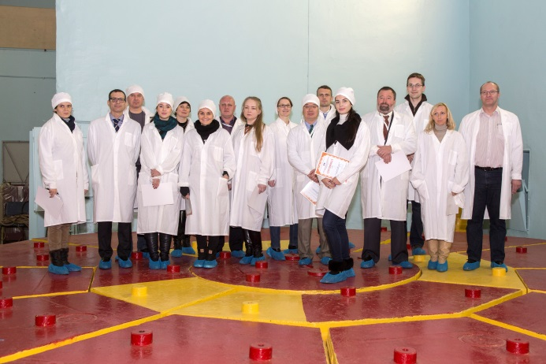
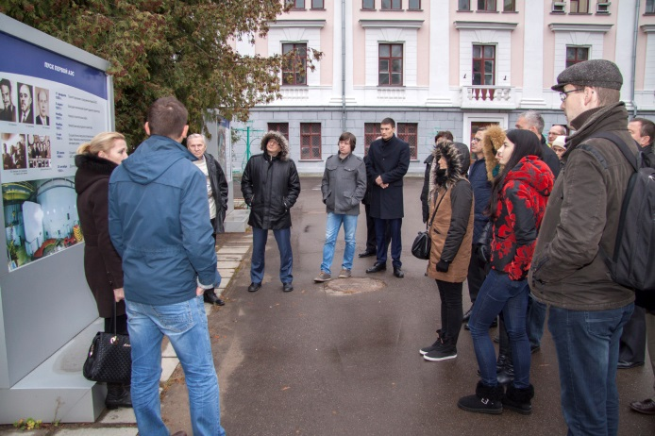
www.decomconference.org
-10-
Technical tour to the first NPP in the world
11 November the technical tour to the first in the world NPP – Obninskaya NPP was held. Skilled specialists of station, some of them work there from the first day of operating, told in detail the history of NPP, its role in development of nuclear industry that is one of baseline of economic and energy safety of country now and main leading industry.
Participants were divided onto two groups for more comfort review of station. English speaking guide followed the group of foreign specialists.
A lot of pictures were taken during the visit.

Slide 11
www.decomconference.org
-11-
Thank you!

