Slide 1
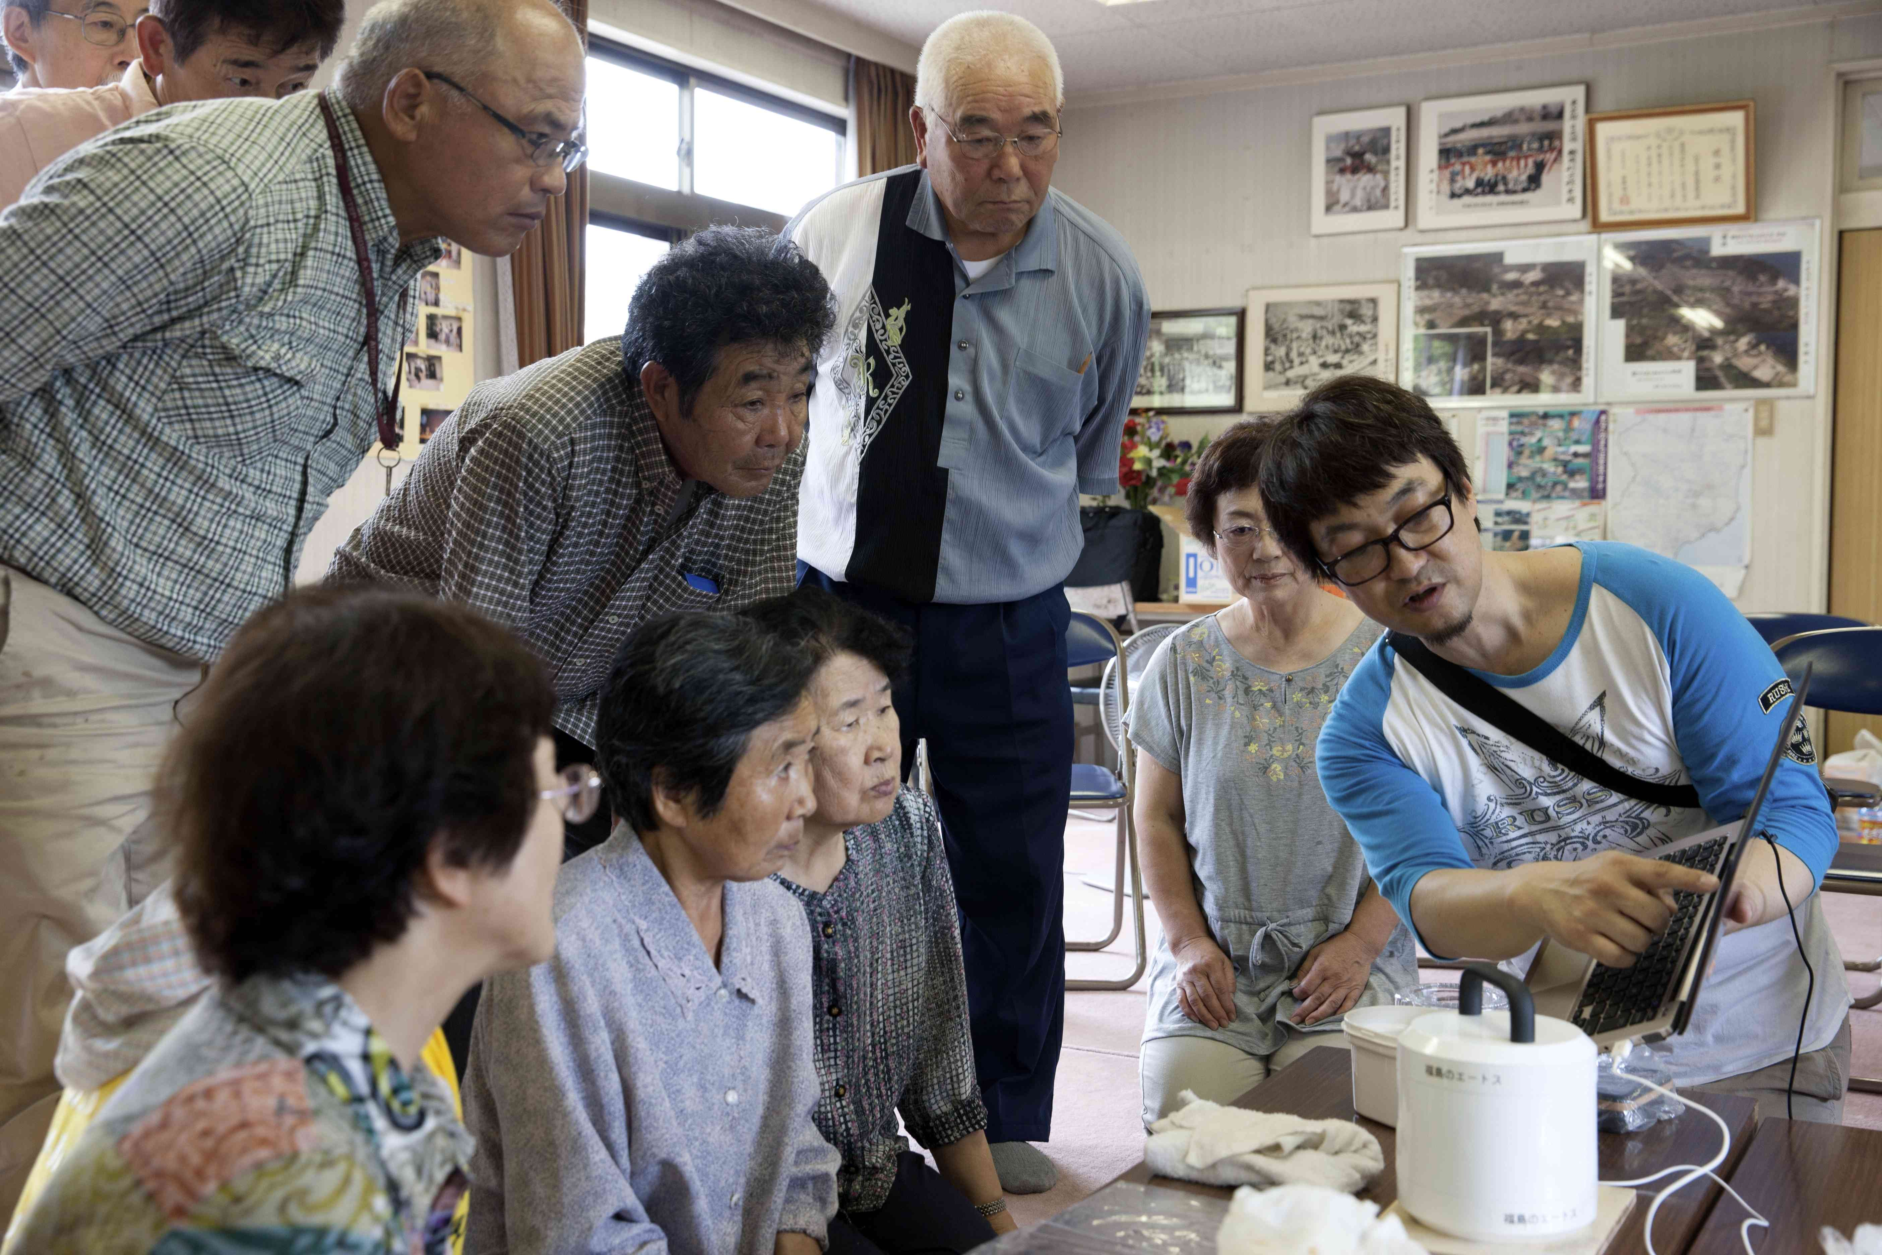
Experience with Stakeholders Engagement in
Post-Accident Situations
Jacques LOCHARD
Vice-Chair of ICRP
International Workshop on
Radiation and Thyroid Cancer
21-23 February 2014
Tokyo, Japan
This presentation has neither been approved nor endorsed by ICRP

Slide 2
Stakeholder engagement
In its most recent general Recommendations (2007) ICRP mentions for the first time “the need to account for the views and concerns of stakeholders when optimising protection” (Pub 103, Editorial)
Why to engage stakeholders?
    To take into account more effectively their concerns and expectations and the specificity of the context at stake
    To adopt more effective and fairer protective actions
    To maintain their vigilance
    To empower them in order to favour their autonomy
2

Slide 3
Autonomy and dignity
      Dignity of individuals is the corollary of autonomy: idea that individuals have the capacity to act freely and morally.
      Autonomy implies the capacity of individuals to deliberate, decide and act
      Dignity means to treat individuals as subjects and not as objects
      Dignity is an attribute of the human condition : every individual deserves unconditional respect, whatever her/his age, sex, health, social condition, ethnic origin and religion
3
Notes:
23/02/14
3

Slide 4
Lessons learned from Chernobyl
- ETHOS project in the Stoyln district, Belarus (1996-2001) -
The direct engagement of local professionals and the population in the day-to-day management of a contaminated territory is a key factor to improve the radiological situation and living conditions of affected inhabitants
This engagement requires the development and dissemination within all segments of the population of “a practical radiation protection culture”
To be effective and sustainable, this engagement also requires:
  the support of authorities
  the involvement of experts serving the population and the local professionals
  the social and economic development of the territories
4

Slide 5
Practical radiation protection culture
  A possible definition:
  The knowledge and skills enabling citizens to make choices and behave wisely in situations involving potential or actual exposure to ionizing radiation
  Practical radiation protection culture allows people:
    To interpret results of measurements
    To orient themselves in relation to radioactivity in everyday life
    To provide information to make decisions and take actions
5

Slide 6
The 3 pillars of stakeholder engagement
An inclusive radiation monitoring system allowing individuals to regain self control on their direct environment i.e. to understand where, when and how they are exposed and what can they do in order to adapt their behaviour and take appropriate actions to protect themselves
A health surveillance system relying on the participation of the inhabitants
The diffusion of the practical radiation protection culture and its transmission to future generations through the education system
6

Slide 7
How to engage stakeholders in the context of contaminated areas ?
    Establishment of places of dialogue
    Listening to their questions, worries, concerns, difficulties, but also their expectations, wishes, desires
    Assessment made ​​jointly between inhabitants and local and national experts
    Implementation of practical projects to address the issues identified as most important with the support of local professionals and authorities
    Evaluation and diffusion of results
  = co-expertise process
7

Slide 8
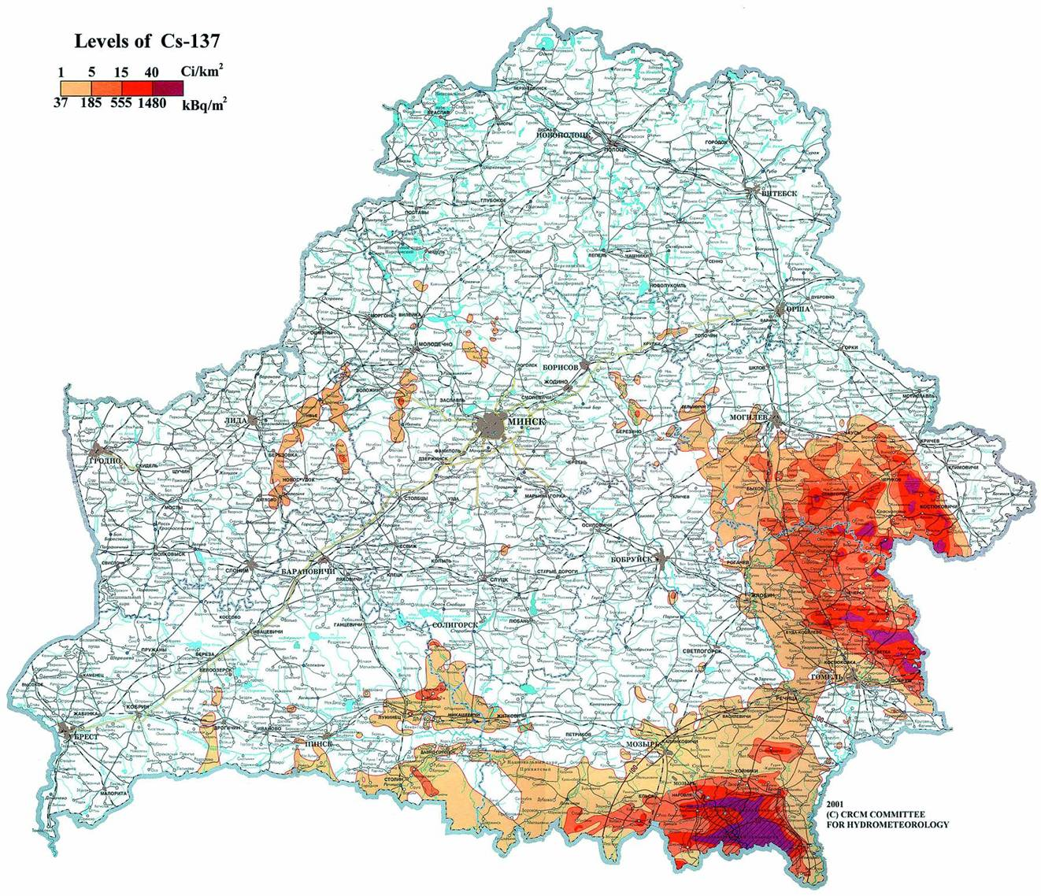
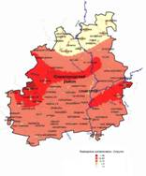
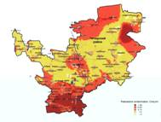
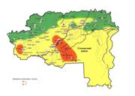

VITEBSK
Chechersk
district
BELARUS
MINSK
MOGILEV
GRODNO
Bragin
district
BREST
GOMEL
Stolyn
district
Chernobyl NPP
8

Slide 9
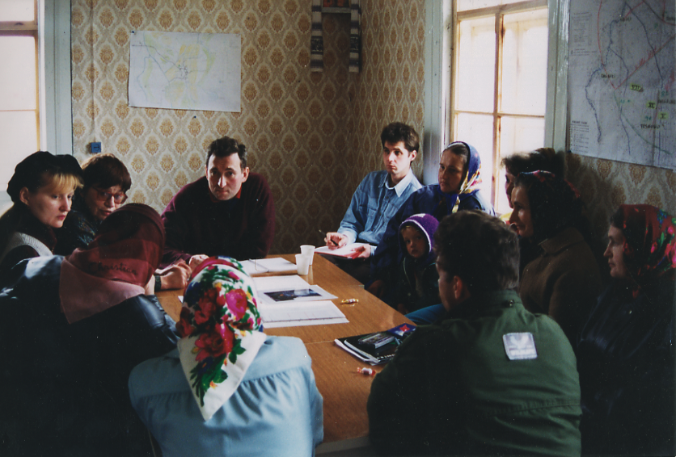
ETHOS project - Dialogue between inhabitants and experts
9

Slide 10
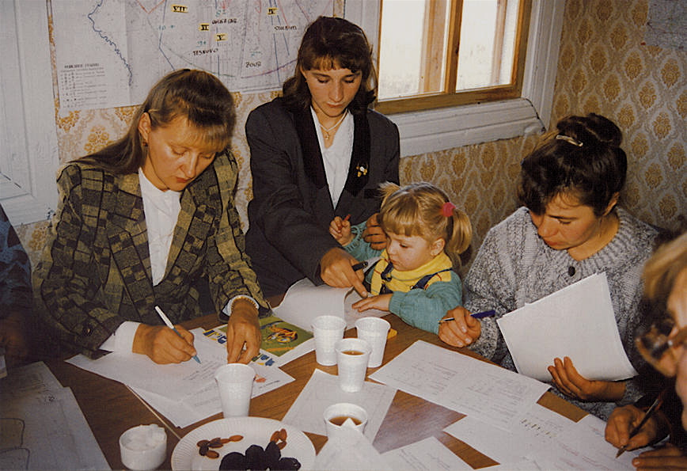
ETHOS project - Young mothers analysing measurement results
10

Slide 11
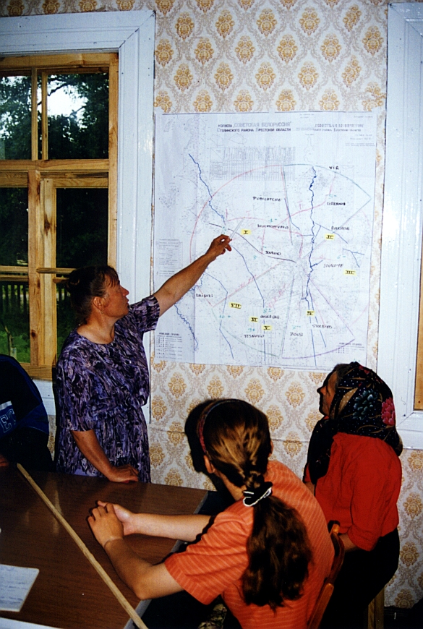
ETHOS project –
Farmers discussing
the management of pastures
11

Slide 12
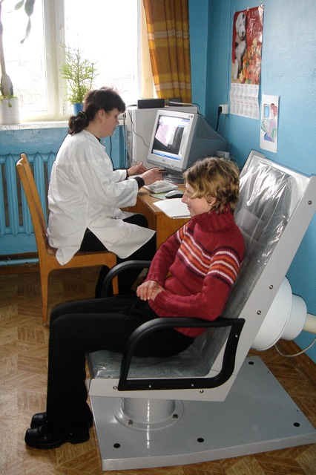
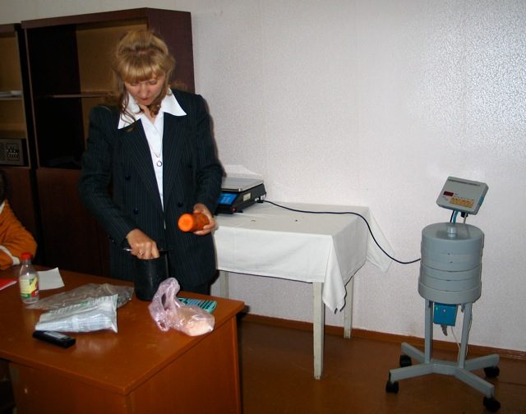
The Bragin project
- CORE program (2004 - 2008) -
    Objective : to implement an integrated monitoring system for the development of the practical radiation protection culture in the population connecting the existing infrastructures : hospitals and clinics, schools, local authorities and administrations, with the support of local professionals and national experts
    Establishment of centres of information and
    practical radiological protection culture
    and whole body measurement campaigns
12

Slide 13
The monitoring system developed in the Bragin district
Families Management
Whole body measurements
Schools Transmission
Centres of information and practical RP culture
Hospital Vigilance
Measurements of food-products
Local authorities Management
13

Slide 14
Whole body measurements
2 whole body measurement campaigns per year
After each campaign, action of a local NGO in relation with the Bragin hospital, the schools and the local centres of radiation protection culture to:
  Identify the most contaminated children
  Dialogue with the concerned families to identify sources of contamination
  Measure the family food-products
  Identify potential room for maneuver
  Monitor the evolution of the internal contamination of children during the following campaigns
14

Slide 15
Results
  More than 8000 measurements from all types of foodstuffs which revealed:
  Large distribution of the levels of contamination for certain products like milk, hay, berries…
  Unexpected evolution of the levels of contamination from year to year e.g. for mushrooms
  No significant reduction of the average levels of contamination during the 5 years of the project
  More than 17 000 individual measurements to follow the whole body contamination of the 2500 children of the district which allowed to:
  Identify the most contaminated children
  Reduce the number of children with an internal contamination > 50 Bq/kg from more than 60 to less than 10
  Divide the maximum level of contamination by 10 and the average individual dose by 3
15

Slide 16
Lessons learnt
  The monitoring system implemented in the Bragin district allowed everyone to:
  Have an easy and direct access to measurements of foodstuffs and her/his own internal contamination
  Understand the radiological situation of her/his own place of living
  Identify the causes of her/his own contamination
  Learn how to reduce her/his own contamination
  Develop her/his practical radiation protection culture
  The system effectively supported the actions implemented in schools by local teachers and in the health care system by local medical staffs to develop the radiation protection culture among the general population and particularly children
16

Slide 17
The Chechersk project
- CORE program (2005 - 2009) -
  Objective : to contribute, through an integrated and inclusive approach involving the local professionals and the population, to the improvement of the health status of the inhabitants and particularly of children
  Two complementary directions:
    Radiological quality: establishment of local centres of information and practical radiation protection culture in the district similar those implemented in the Bragin project
    Health surveillance: implementation of health checks for children to characterize their pathologies and to identify possible risk factors associated with these pathologies
17

Slide 18
The health surveillance system developed in the Chechersk project
SCREENING, CARES, RESEARCH
Health professionals
Diagnosis and treatments
Researchers
Risk factors
Centres of RP culture - regular health checks
Health professionals
Information of patients and public
Population
Management of the radiological situation
PREVENTION, INFORMATION, RADIATION PROTECTION CULTURE
18

Slide 19
Health checks of children
  Follow-up of 2500 children from 3 to 15 years (more than 90% of the number of children of the district)
    About 30 indicators describing the context (age, sex, diet, places of residence, living conditions, etc.) and the health status (physical and biological parameters - blood analysis, electrocardiogram - search of dysfunctions or pathologies) collected 3 times between 2006 and 2009
    3 whole body measurement campaigns
  Children with pathologies identified during the check-ups have immediately received treatments either in the Chechersk hospital or in the Republican Research Centre for Radiation Medicine and Human Ecology of Gomel
  They also received, as well as their families, information on the way to improve their radiological situation by involving themselves in the management of the situation
19

Slide 20
Results
  Whole body measurements. 72% of children <20 Bq/kg; 19% between 20 and 50 Bq/kg ; 9 % > 50 Bq/kg. Only 7 children with contamination >100 Bq/kg
  Health checks. Purely descriptive they helped to highlight the prevalence of diseases among the children, including thyroid diseases, ophthalmic diseases, and cardiovascular dysfunctions
  Variations were identified based on living conditions and surface contamination but it was very difficult to draw any firm conclusions given the interrelation between these two factors
  No correlations were observed between the identified diseases and the levels of internal contamination of children with cesium-137
20

Slide 21
Lessons learnt
  The Chechersk project has highlighted the importance to raise awareness of the most vulnerable individuals (particularly children and pregnant women) about the practical radiation protection culture to avoid risky behaviours
  The project has also revealed the importance of training health professionals to radiation protection and dialogue techniques, to inform and advice their patients, and also to re-enforce their role in the management of the radiological situation
  Beyond the need to provide the population with an objective information on its health status there is also the need to develop an interactive approach between the population and the medical professionals to produce, interpret and present this information
21

Slide 22
Concluding remarks (1)
The Chernobyl experience and now the Fukushima experience show that the direct engagement of the affected people in the day-to-day management of a contaminated territory is not only feasible but necessary to improve their radiological situation and living conditions and finally restore or preserve their dignity
  Because of the primary concern of the affected population about health, and particularly the future health of children, detailed and regular monitoring of the health status of individuals in relation to the radiological quality of their environment and the food products they consume is a key pillar of a post accident recovery strategy in order to:
  Detect and treat diseases among the general population
  Identify individuals and groups of population at larger risks than the average
  Contribute to better understand the direct and indirect health effects of living in a contaminated environment, and to improve prevention
22

Slide 23
Concluding remarks (2)
The Commission is currently updating Publications ICRP 109 and 111 (2009) concerning its recommendations for the protection of people during the emergency and recovery phases of a nuclear accident
This update will consider among other the already considerable Fukushima experience related to stakeholder engagement, radiation monitoring and health surveillance
In this perspective the recent document “Practical Measures for Evacuees to Return Their Homes” published by the Nuclear Regulatory Authority, Japan is a particularly valuable source. See:
http://www.nsr.go.jp/english/library/data/special-report_20140204.pdf
For further information concerning ICRP activities related to Fukushima see: http://new.icrp.org/page.asp?id=188
23

Slide 24
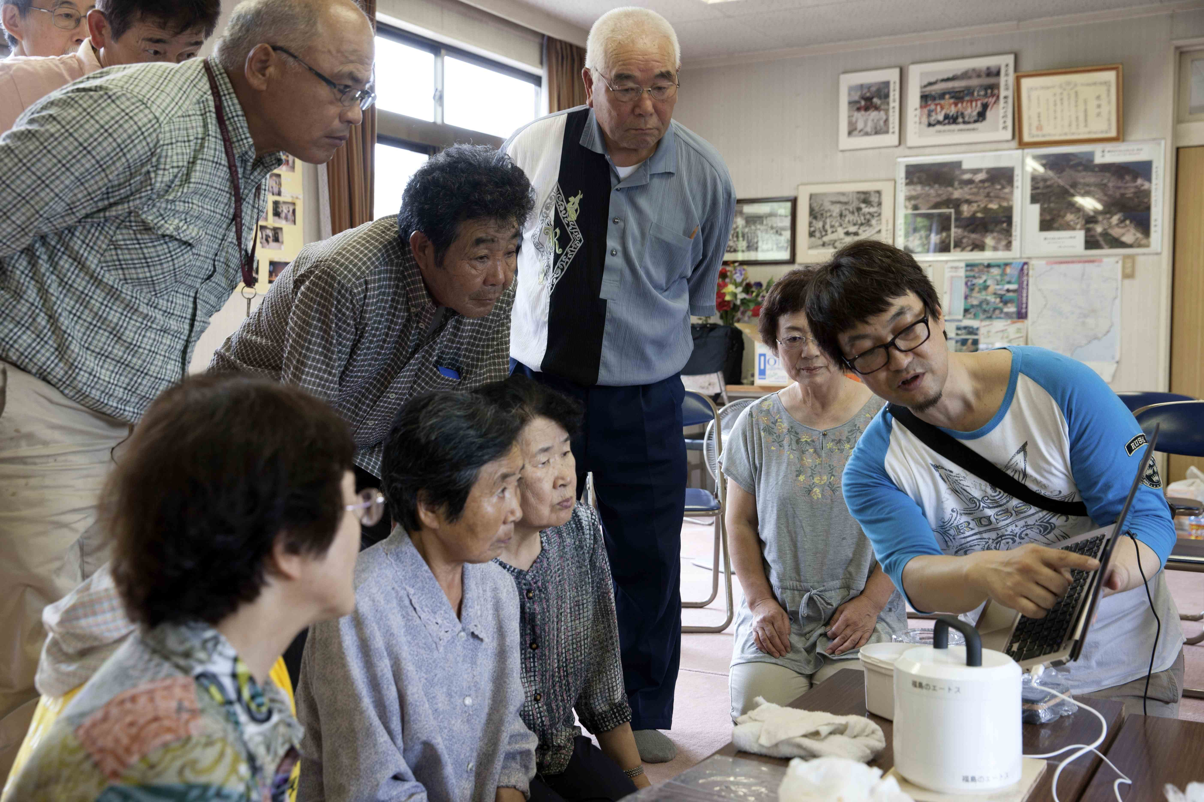
Measurement of food products from gardens, Suetsugi, July 2013
24

Slide 25

www.icrp.org

