Slide 1
Ultrasonography survey and thyroid cancer in Fukushima Prefecture Peter Jacob, Alexander Ulanovsky, Christian Kaiser Department of Radiation Sciences Institute of Radiation Protection Workshop Radiation and Thyroid Cancer, Tokyo, 21-23 February 2014

Slide 2
Questions addressed
Under the condition of on-going ultrasonographic screening in Fukushima Prefecture,
what are the expectations concerning thyroid cancer in the screened population?
Prevalenceª during first screening
Subsequent incidence^{b} independent of exposure from accident
Incidence due to exposure from accident
Detectability of radiation effect
ª Number of cases per number of individuals screened
^{b} Number of new cases per number of individuals screened during a certain time period

Slide 3
1. Prevalence
1.1 Basic assumption
If the same screening protocol would have been applied, then
the ratios of prevalence in screened cohort and country-specific incidence rate
in Fukushima Prefecture and in UkrAm cohort
should be are equal
P_{Fp} / λ_{Japan,Fp} = P_{UA1} / λ_{Ukraine,UA1} for hypothetical same screening

Slide 4
1. Prevalence
1.1 Basic assumption (continued)
Ratios of prevalence in screened cohort and country-specific incidence rate
in Fukushima Prefecture and in UkrAm cohort
are equal except a factor taking account of the study protocol, f_{sp}
P_{Fp} / λ_{Japan,Fp} = f_{sp} P_{UA1} / λ_{Ukraine,UA1}

Slide 5
1. Prevalence
1.2 Data on prevalence
UkrAm cohort, first screening: 13 127 participants, average age: 22 years
11.2 (95%CI: 3.2; 22.5) cases not associated with radiation
P_{UA} =0.09% (95%CI: 0.02%; 0.17%)
Tronko et al. J Natl Cancer Inst 2006
# nodules > 5 mm / # nodules > 10 mm = 1568 / 475 = 3.3
f_{sp} = triangular distribution [1; 3.2]ª
ª based on data as of 31 July 2013
Fukushima Medical University (2013) http://www.fmu.ac.jp/radiationhealth/results/media/13-2_ThyroidUE.pdf
Jacob et al. Radiat Environ Biophys 2014

Slide 6
1. Prevalence
1.2 Data on prevalence (continued)
Size distributions in Hong-Kong study similar for nodules and tumors:
# nodules > 5 mm / # nodules > 10 mm = 398 / 169 = 2.4
# tumors > 5 mm / # tumors > 10 mm = 11 / 5 = 2.2
Yuen et al. Head Neck 2011

Slide 7
1. Prevalence
1.3 Data on country-specific incidence rates
Cases per 10⁵ person-years
National Cancer Center
http://ganjoko.jp/pro/statistics/en/ table download.html
2007
Age (years)
λ_{Japan,Fp} = 0.3 cases per 10⁵ person-years (0.0003 %/year)
λ_{Ukraine,UA1} = 1.8 cases per 10⁵ person-years (0.0018%/year)

Slide 8
1. Prevalence
1.4 Results on prevalence
Municipalities/Prefectures | Targeted period of screening | Predicted prevalence (%) ª
13 in Fukushima Prefecture | Apr 2011–Mar 2012 | 0.027 (0.007, 0.069)
12 in Fukushima Prefecture | Apr 2012–Mar 2013 | 0.034 (0.009, 0.088)
Aomori, Yamanashi and Nagasaki | Nov 2012–Jan 2013 | 0.032 (0.008, 0.084)
ª arithmetic mean and 95% confidence interval
Jacob et al. Radiat Environ Biophys 2014
Observed prevalence in municipalities targeted April 2011 – Mar 2012:
13/41493 = 0.031 % as of 30 Sep 2013
Fukushima Medical University (2013) http://www.fmu.ac.jp/radiationhealth/results/media/13-2_ThyroidUE.pdf

Slide 9
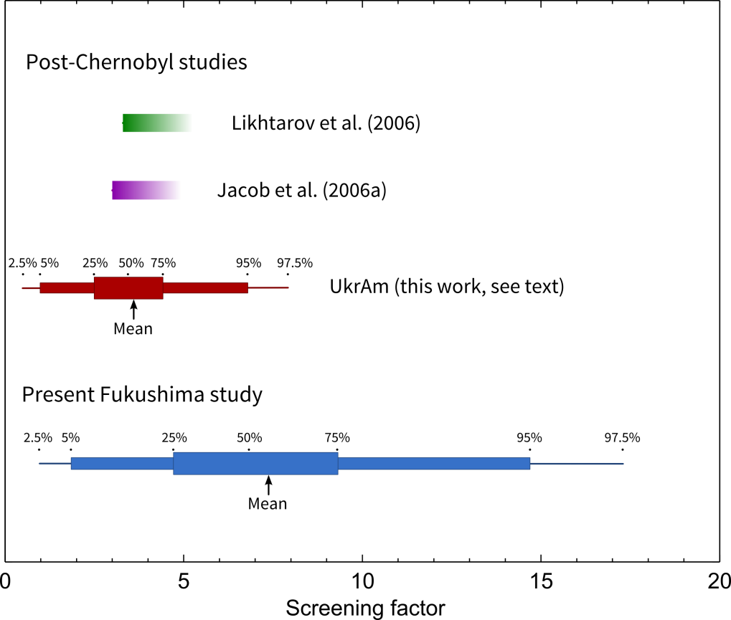
2. Incidence not related to radiation from accident
2.1 Screening factor for incidence
Screening factor in Fukushima Prefecture
= Screening factor in UkrAm cohort * f_{sp}
= (EAR_{UA}/ERR_{UA})/λ_{Ukraine,UA2-4} * f_{sp}
= 7.4 (95% CI: 0.95; 17.3⁾
Brenner et al. Environ Health Persp 2011
Jacob et al. Radiat Environ Biophys 2014
, F_{scr}

Slide 10
2. Incidence not related to radiation from accident
2.2 Results
Presented in Section 3

Slide 11
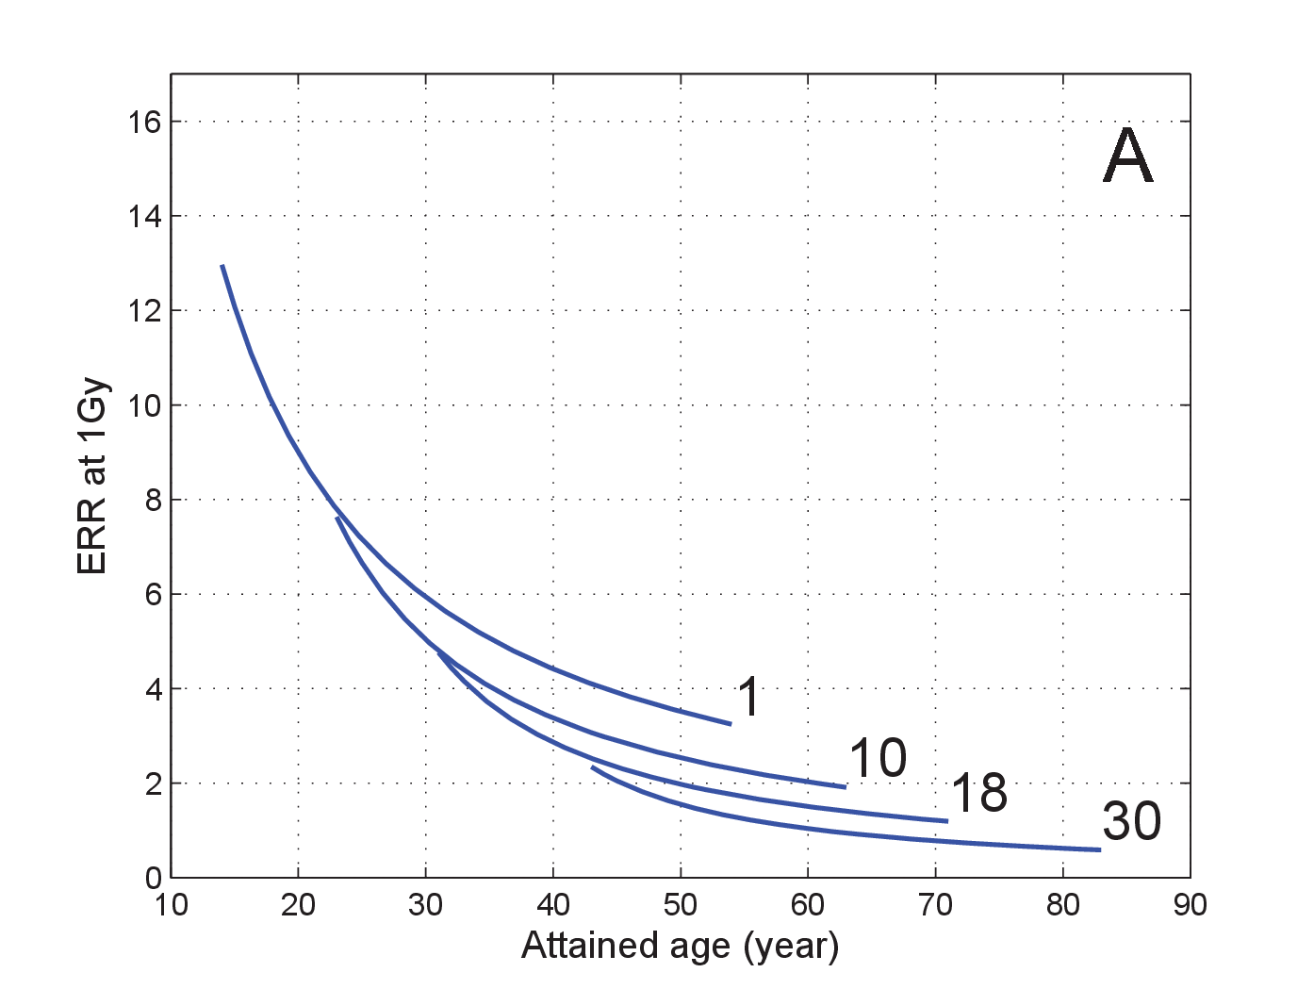
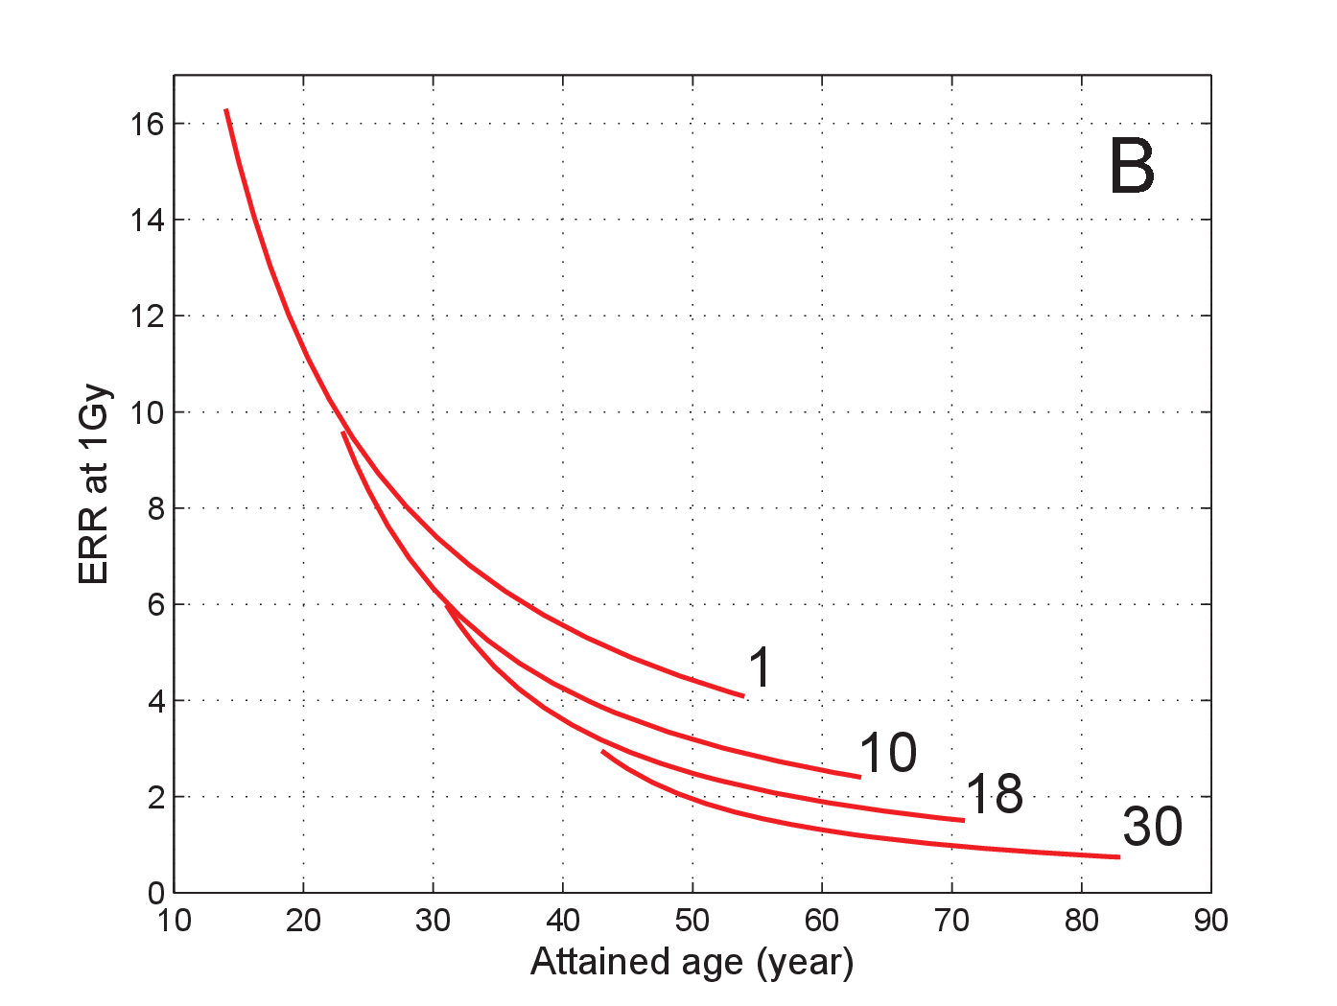
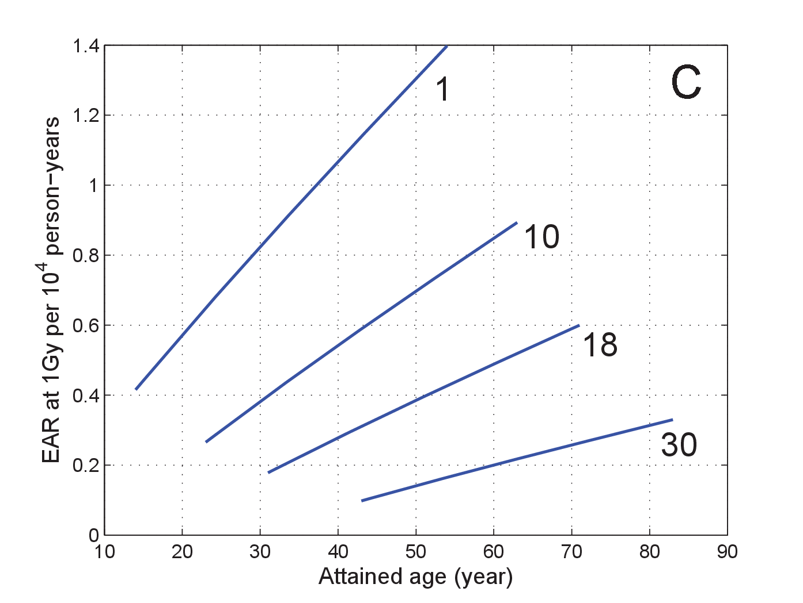
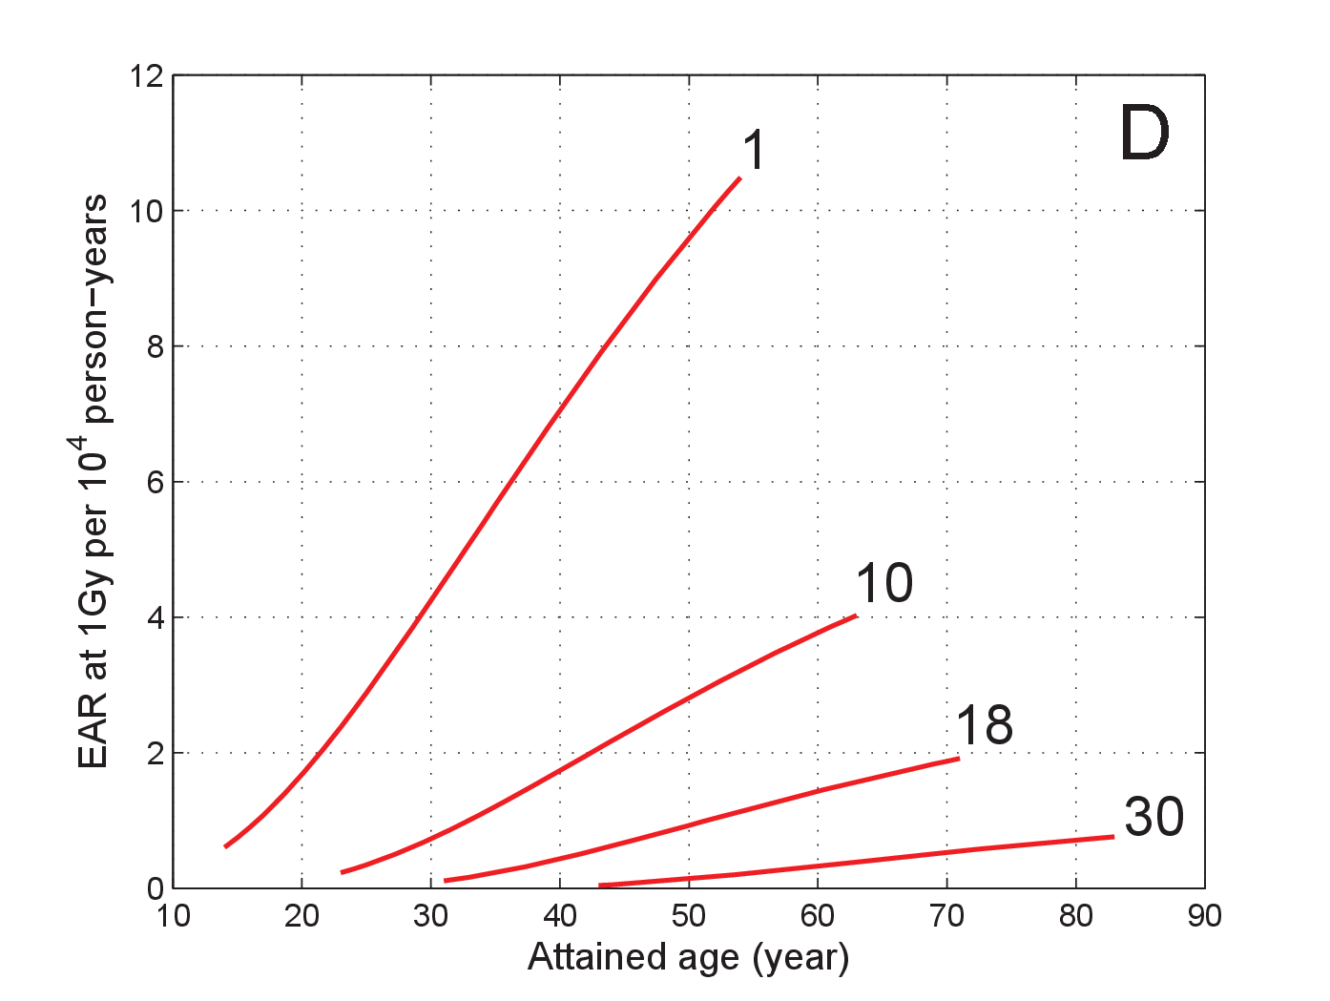
3. Incidence due to exposure from accident
3.1 Risk model for LSS members not participating in AHS
males
females
Relative risk decreases with increasing age at exposure and age attained
Excess rate decreases with increasing age at exposure and increases with increasing time since exposure
males
females
Jacob et al. Radiat Environ Biophys 2014

Slide 12
3. Incidence due to exposure from accident
3.2 Excess absolute rate per unit dose
Transfer of relative risk from LSS to Fukushima Prefecture
EAR_{Fp}(s,e,a) = F_{scr} F_{L}(a-e) F_{DDREF} ERR_{LSS}(s,e,a) λ_{Japan}(s,a)
F_{DDREF} Uncertainty due to transfer to low dose and low dose rate
F_{L}(a-e) Minimal latency period of 3 years
F_{scr} Screening factor
Predicts zero excess rate for young age attained => mixed transfer more plausible
Heidenreich et al. Radiat Res 1999 (F_{L})
Jacob et al. Occup Environ Med 2009 (F_{DDREF})
Jacob et al. Radiat Environ Biophys 2014 (F_{scr}, ERR_{LSS})
National Cancer Center, http://ganjoho.jp/pro/statistcs/en/table download.html (λ_{Japan})

Slide 13
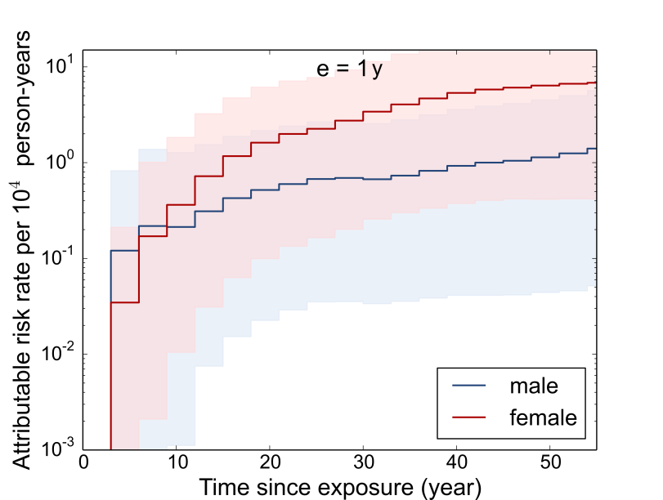
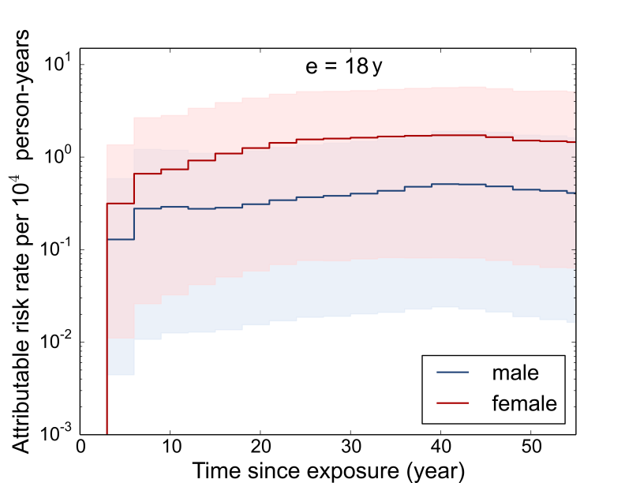
3. Incidence due to exposure from accident
3.3 Excess absolute rate at 100 mGy
Jacob et al. Radiat Environ Biophys 2014

Slide 14
3. Incidence due to exposure from accident
3.4 Predicted incidence during two time periods
Baseline and attributable to assumed thyroid dose of 20 mGy
Thyroid cancer | Incidence (%)
 | 10 years | 50 years
Baseline | 0.06 (0.006; 0.14) | 2.2 (0.27; 5.3)
Excess | 0.006 (0.0002; 0.025) | 0.13 (0.005; 0.40)
Main sources of uncertainty: F_{scr}, ERR_{LSS}, F_{DDREF}
Jacob et al. Radiat Environ Biophys 2014

Slide 15
3. Incidence due to exposure from accident
3.5 Will radiation effects become detectable?
According to best estimates for female infants:
If a few thousand female infants would have a thyroid dose in the order of 50 mGy,
then the radiation effects will possibly be detectable after several decades
However, uncertainties are large:
Radiation effects may also become detactable for lower doses or smaller exposed groups

Slide 16
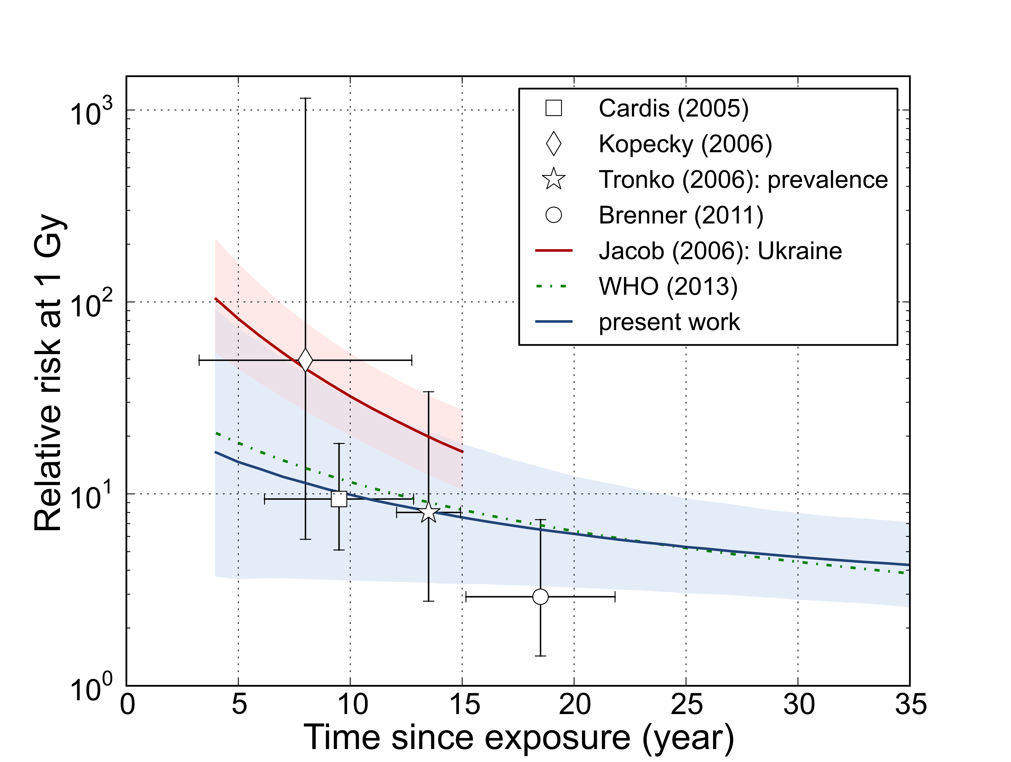
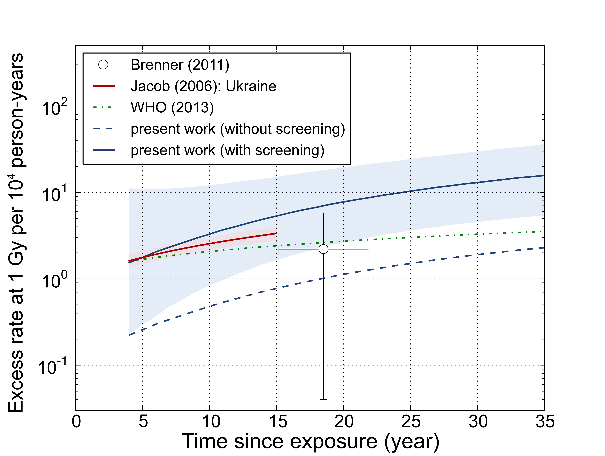
4.1 Excess risk for thyroid cancer in post-Chernobyl studies
4. Comparison with other studies
e = 7 years
e = 7 years

Slide 17
4. Comparison with other studies
4.2 Thyroid cancer risk predictions for 100 mGy by WHO (2013)
Females, 10y at exposure | WHO (2013) | Jacob et al. (2014) | Ratio
LAR | 0.25% | 1.6% | 6.5
RR, lifetime | 0.33 | 0.24 | 0.7
AR₁₅ | 0.03% | 0.09% | 2.9
RR, 15 years | 1.1 | 0.53 | 0.5
Compared to WHO (2013), Jacob et al. (2014) predict
higher thyroid cancer rates, because of ultrasonography survey
slightly lower relative risks especially for first few decades after exposure of girls, because of differences in radiation risk function

Slide 18
Summary of predictions for continued ultrasonography (1)
Predictions based on prevalence and screening factor in UkrAm study, and thyroid cancer risk function in LSS members not participating in the AHS
Prevalence during first screening: 0.034% (95% CI: 0.009%; 0.085%)
Screening factor for incidence rate: 7 (95% CI: 1; 17)
Thyroid cancer incidence over 50 years: 2% (95% CI: 0.3%; 5%)
Excess 50y-incidence from thyroid dose 20 mGy: 0.1% (95% CI: 0.005%; 0.4%)

Slide 19
Summary of predictions for continued ultrasonography (2)
Excess 50y-incidence from thyroid dose 20 mGy: 0.1% (95% CI: 0.005%; 0.4%) Less than 5% of 50y-excess accumulate during first 10 years
Large uncertainties related to F_{scr} , ERR_{LSS}, F_{DDREF} and thyroid dose
Good agreement with post-Chernobyl studies
Compared to WHO higher rates, but lower relative risks (especially for first decades after exposure of girls)

Slide 20
Summary of predictions for continued ultrasonography
Predictions based on prevalence and screening factor in UkrAm study, and thyroid cancer risk function in LSS members not participating in the AHS
Prevalence during first screening: 0.034% (95% CI: 0.009%; 0.085%)
Screening factor for incidence rate: 7 (95% CI: 1; 17)
Thyroid cancer incidence over 50 years: 2% (95% CI: 0.3%; 5%)
Excess 50y-incidence from thyroid dose 20 mGy: 0.1% (95% CI: 0.005%; 0.4%) Less than 5% of 50y-excess accumulate during first 10 years
Large uncertainties related to F_{scr} , ERR_{LSS}, F_{DDREF} and thyroid dose
Good agreement with post-Chernobyl studies
Compared to WHO higher rates, but lower relative risks (especially for first decades after exposure of girls)
Thank you for your attention !

