Slide 1
NIRS Estimation of Internal Dose to the Thyroid
The International Workshop on Radiation and Thyroid Cancer
(Organized by OECD/NEA)
at Prince Hotel, Tokyo – Japan
22 February, 2014
Osamu KURIHARA, Ph.D
National Institute of Radiological Sciences (NIRS)
1

Slide 2
Contents
Background
Methods for Estimating Early Internal Doses (Thyroid Equivalent Doses) to Fukushima Residents
Results of the Estimation
Summary and Discussion
2

Slide 3
Background
Limited human/environmental data available for estimating early internal doses to the public due to the intake of short-lived nuclides (mainly, ¹³¹I)
The number of direct human measurements in the first second months is only ~ 1,300 (excluding workers).
  Screening survey on thyroid exposure to 1,080 children: Fukushima (2012), Kim et al. (2012)
  Measurements of ¹³¹I in the thyroid for 62 Namie residents: Tokonami et al. (2012)
  Measurements for 173 subjects (first responders/evacuees) in the first month: Matsuda et al. (2013)
NIRS started a project on the reconstruction of internal doses to Fukushima residents in 2012 (ongoing).
3

Slide 4
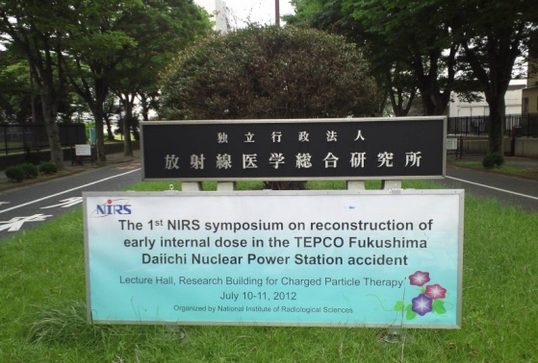
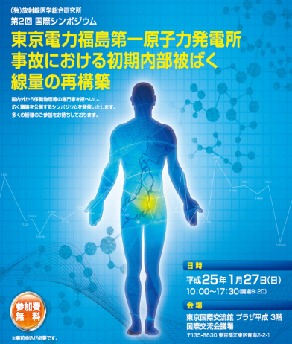
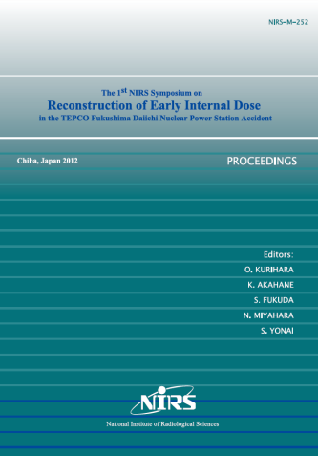
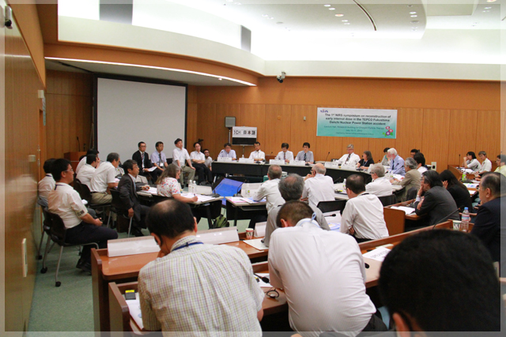
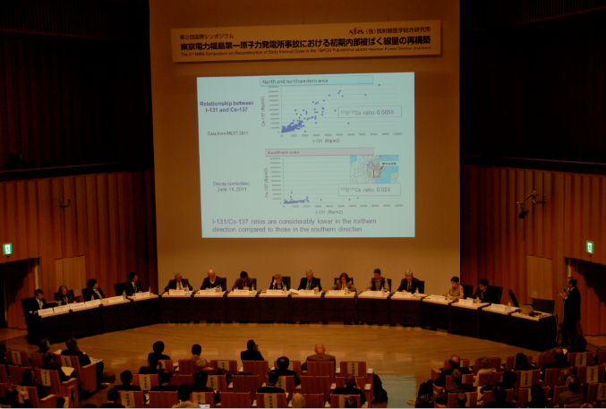
Symposium by NIRS
Proceedings
of the first symposium*
(including 17 reviewed papers)
First symposium
on Jul. 10-11, 2012
(at NIRS)
Second symposium
on Jan. 27, 2013
(at Tokyo)
* Available from http://www.nirs.go.jp/publication/irregular/pdf/nirs_m_252.pdf
4

Slide 5
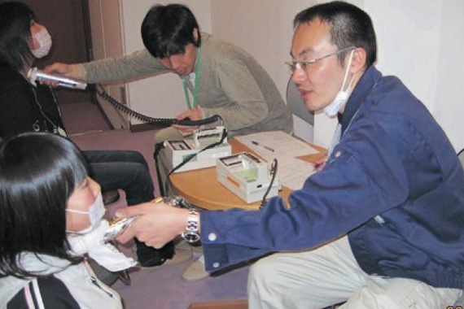
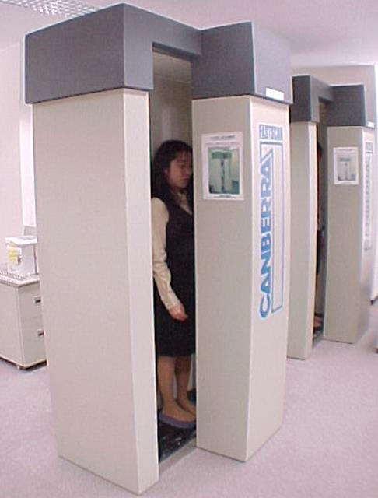
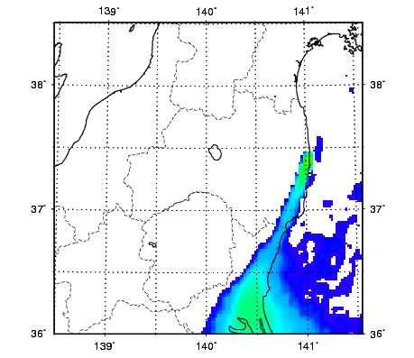
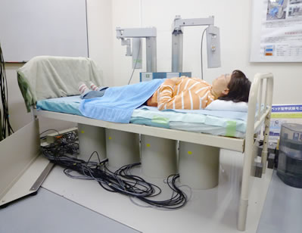
Methods for Estimating Thyroid Dose
NIRS Approach
Thyroid measurements
WB measurements
Atmospheric dispersion
simulations
The most reliable data for the dose estimation
However, a relatively small number…
A relatively large number of measurements
Intake ratio I to Cs is needed.
Spatiotemporal map of radionuclides in air
Not enough data for the validation
ICRP model for Internal Dose Calculation
Representative values of the thyroid dose
for Fukushima residents
5

Slide 6
Main Resources for the Estimation
Method | Data
Thyroid measurements | 1,080 subjects (≤ 15 y) of the screening survey on thyroid exposure to children in Kawamata, Iwaki and Iitate Fukushima, J. Health Phys. (2012) Kim et al., NIRS-M-252 (2012) Available data: subjects’ information (age, sex), measurement place and date, raw data of readings of NaI survey meters
WB measurements | ~ 3,000 adult subjects of twelve municipalities Momose et al., NIRS-M-252 (2012) Available data: only committed effective doses based on an acute intake scenario (via inhalation) on March 12, 2011.
Atmospheric dispersion simulation | WSPEEDI-II with the latest source term (provided from JAEA) Terada et al., J. Environ. Radioact. (2012)
Additional information: mainly air sampling by JAEA or TEPCO
Physicochemical form of iodine: 60% of volatile form and 40% of particulate form (as concentration-weighted mean)
Contribution to the thyroid dose from nuclides other than ¹³¹I: ~ 10%
6

Slide 7
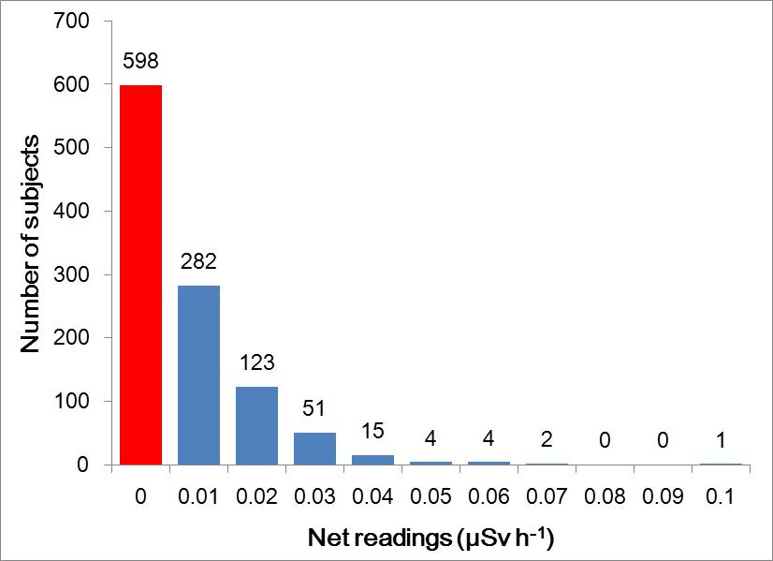
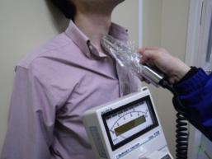
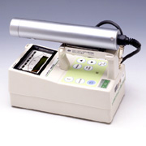
Thyroid Measurements
Measurements were performed using NaI(Tl) survey meters (TCS-161, 171 and 172, Hitachi-Aloka Medical, Ltd.).
Calibration was performed using a human neck phantom containing thyroid-shaped bottle (Kyoto Kagaku Co. Ltd).
No collimator
BG level (room): < 0.2 µSv h⁻¹ (instructed by the protocol)
BG was also measured at the subject’s shoulder.
Number of subjects
Net reading (µSv h⁻¹)
All subjects were below the screening level (0.2 µSv h⁻¹)
corresponding to 100 mSv for 1-yr-old children.
Calculations of thyroid doses based on the revised calibration factors of devices and two possible intake scenarios.
7

Slide 8
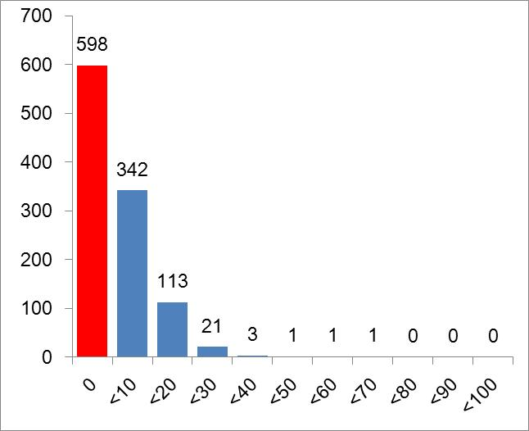
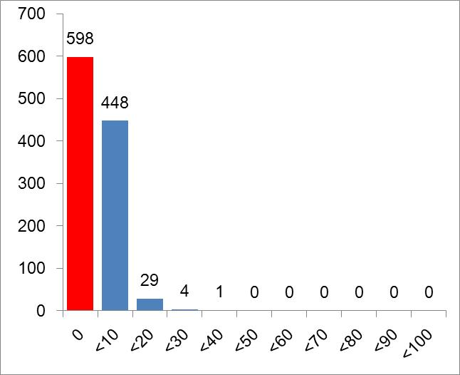
Estimated Thyroid Doses (1)
Scenario 1
Acute intake on March 15
Scenario 2
Chorionic intake from March 12 to day before measurement
Number of subjects
Number of subjects
Thyroid equivalent dose (mSv)
Thyroid equivalent dose (mSv)
99% subjects are below 30 mSv.
8

Slide 9
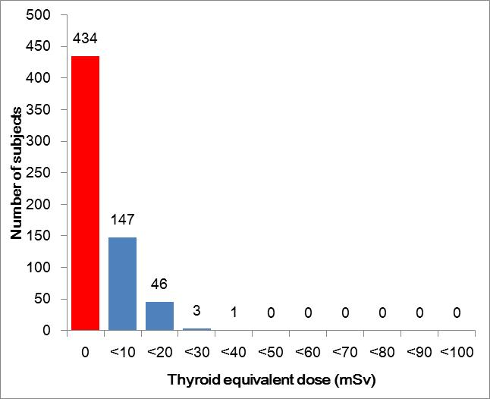
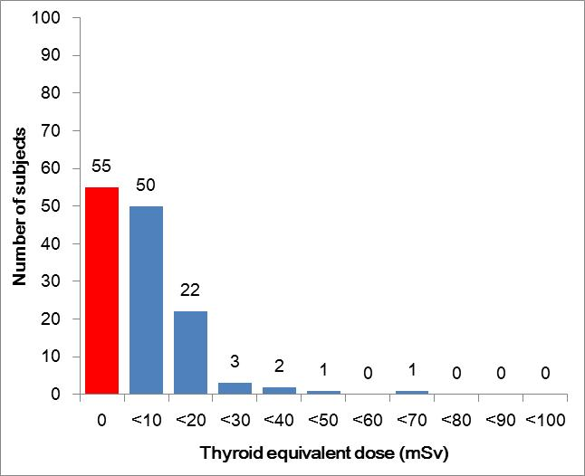
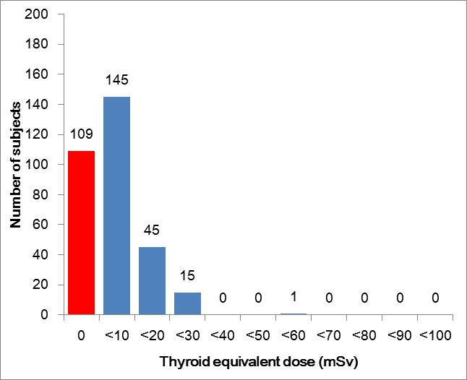
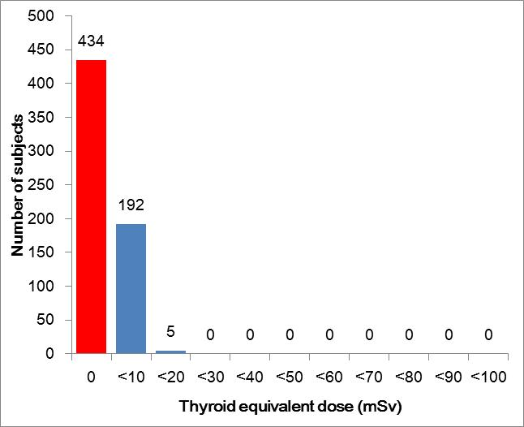
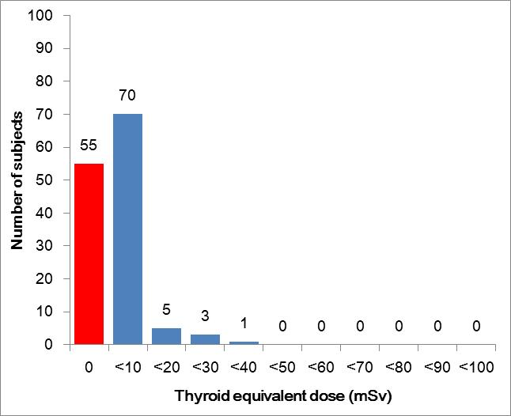
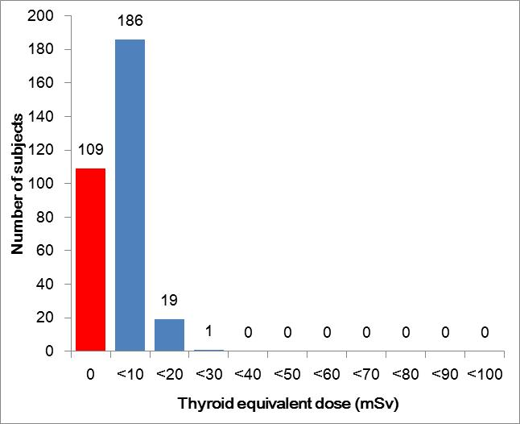
Estimated Thyroid Doses (2)
Kawamata
Iwaki
Iitate
Scenario 1
Scenario 1
Scenario 1
Scenario 2
(Chronic intake)
Scenario 2
(Chronic intake)
Scenario 2
(Chronic intake)
Scenario 2
Scenario 2
Scenario 2
9

Slide 10
CED Distribution from WB Meas. (1)
Committed Effective Dose (CED) for Adult Subjects of Each Municipality
Figures are reproduced from the published data of WB meas. from Jul. 2011 to Jan. 2012 (Momose et al., 2012).
CEDs are estimated from WB contents of ¹³⁴Cs and ¹³⁷Cs on the assumption of acute intake on March 12.
The lowest band on each figure corresponds to subjects with no significant detection.
10

Slide 11
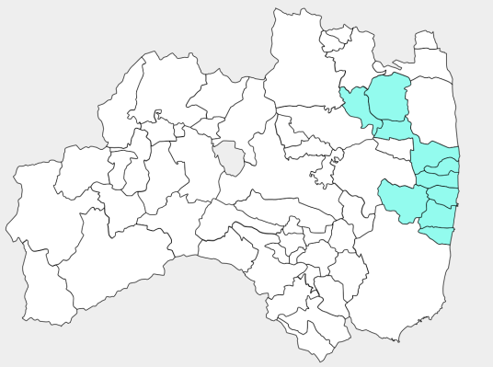

CED Distribution from WB Meas. (2)
CEDs for Adult Subjects of Each Municipality
Municipality | Number of subjects | 90 percentile (mSv) | 50 percentile^{*1} (mSv)
Futaba | 365 | 0.15 | 0.04
Okuma | 561 | 0.10 | 0.02
Tomioka | 696 | 0.08 | 0.01
Naraha | 241 | 0.06 | 0.01
Hirono | 210 | 0.10 | 0.05
Namie | 614 | 0.10 | 0.02
Iitate | 184 | 0.17 | 0.03
Kawamata | 120 | 0.07 | 0.01
Kawauchi | 64 | < 0.01 | < 0.01
All^{*2} | 3128 | 0.10 | 0.02
Kawamata
Iitate
Namie
Futaba
Okuma
Tomioka
Naraha
Hirono
Kawauchi
*1 The 50 percentile values of CEDs are calculated assuming a log-normal
distribution (excluding Iitate and Kawamata).
*2 Including CEDs of Date, Minami-soma, Katsurao (not shown in Table)
11

Slide 12


Estimation of Intake Ratio (¹³¹I/Cs)
Estimation of intake ratio (¹³¹I/Cs) from two dose distributions
WB meas.
Assumption: Adult and child inhale ¹³¹I and Cs with the same ratio (but different volume).
Cs
Effective dose
¹³¹I
Intake Ratio (¹³¹I/Cs)
Cs
¹³¹I
Thyroid dose
Thyroid meas.
Adult
Child
Effective doses for adults (¹³⁴Cs and ¹³⁷Cs)
The both are available in Iitate and Kawamata.
Thyroid doses for children (¹³¹I)
12

Slide 13
Converting CED to Thyroid Doses
1 mSv of CED* from ¹³⁴Cs/¹³⁷Cs for adults
* CED: Committed Effective Dose
Intake via inhalation: 9E+04 Bq for each Cs
Assuming ¹³¹I/¹³⁷Cs = 1
Intake via inhalation: 9E+04 Bq for ¹³¹I
1-yr children
Ventilation rate: 5.16 m³/day
¹³¹I Intake: 2E+04 Bq
10-yr children
Ventilation rate: 15.3 m³/day
¹³¹I Intake: 6E+04 Bq
Adults
Ventilation rate: 22.2 m³/day
¹³¹I Intake: 9E+04 Bq
Dose coefficients of iodine (vapor: particle = 0.6: 0.4) are used.
Contribution from other nuclides was assumed to be 10%.
Thyroid dose: 60 mSv
Thyroid dose: 50 mSv
Thyroid dose: 30 mSv
13

Slide 14
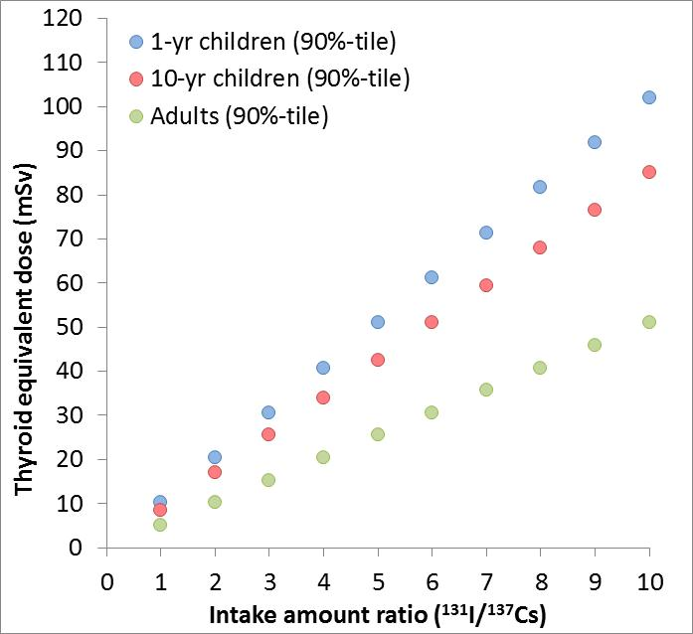
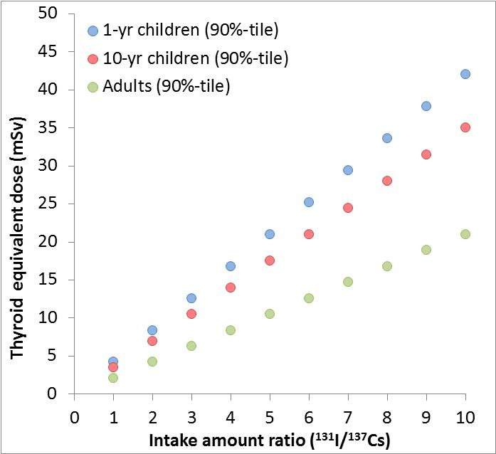
Derivation of Intake Ratio (¹³¹I/Cs)
Iitate
CED from WB: 0.17 mSv (adults)
Thyroid dose: 15 mSv (children)
(90%-tile value)
Kawamata
CED from WB: 0.07 mSv (adults)
Thyroid dose: 7 mSv (children)
(90%-tile value)
In case of ¹³¹I/¹³⁷Cs =1
For Iitate, thyroid doses are …
1 yr: 0.17mSv×60 = 10.2mSv
10 yr: 0.17mSv×50 = 8.5mSv
Adults: 0.17mSv×30 = 5.1mSv
In case of ¹³¹I/¹³⁷Cs =1
For Kawamata, thyroid doses are …
1 yr: 0.07mSv×60 = 4.2mSv
10 yr: 0.07mSv×50 = 3.5mSv
Adults: 0.07mSv×30 = 2.1mSv
Iitate
In case of ¹³¹I/¹³⁷Cs = 2
1 yr: 10.2mSv×2 = 20.4 mSv
10 yr: 8.5mSv×2 = 17.0 mSv
Adults: 5.1mSv×2 = 10.2 mSv
In case of ¹³¹I/¹³⁷Cs = 2
1 yr: 4.2mSv×2 = 8.4 mSv
10 yr: 3.5mSv×2 = 7.0 mSv
Adults: 2.1mSv×2 = 4.2 mSv
15mSv
7mSv
Intake ratio(¹³¹I/¹³⁷Cs) of 3 was applied to the estimation.
14

Slide 15
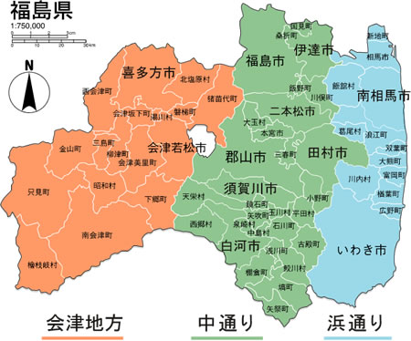
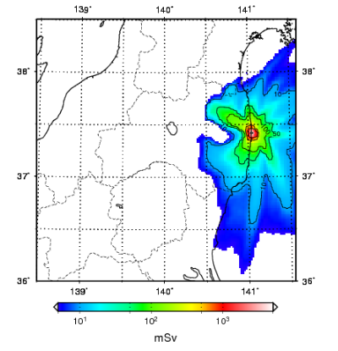
Thyroid Doses by Simulations
Thyroid dose map for 1-yr-old children
(inhalation)
100 mSv <
Aizu
Naka-dori
Hamadori
< 10 mSv
≤ 10 mSv
10 mSv <
Integrated period: from March 12 to March 31
Assumption: staying outside
all the time up to March 31
Comparing with thyroid doses
estimated from human data

Slide 16
Comparison between simulations and thyroid measurements
Thyroid doses by simulations are calculated using air concentrations at the mesh where a local government office of each is placed and surrounded eight meshes.
Kawamata
Iwaki
Iitate
Scenario 1
Scenario 1
Scenario 1
Scenario 1
(Acute intake)
Scenario 1
(Acute intake)
Scenario 1
(Acute intake)
Blue lines: thyroid measurements, Red lines and pink bands: simulations
Simulations predict thyroid doses higher than 90 percentile values of those from thyroid measurements.
Applicable to residents in Nakadori and Aizu where human measurement data are unavailable.
16

Slide 17
Results of the Estimation
90 percentile of thyroid equivalent dose (rounded to nearest 10%)
Unit: mSv
Municipality | Children (1-yr-old) | Adults | Methods^{*1}
Futaba | 30 | 10 | WB
Okuma | 20 | < 10 | WB
Tomioka | 10 | < 10 | WB
Naraha | 10 | < 10 | WB
Hirono | 20 | < 10 | WB
Namie | 20 | < 10 | WB, Thyroid^{*2}
Iitate | 30 | 20 | Thyroid, WB
Kawamata | 10 | < 10 | Thyroid, WB
Kawauchi | < 10 | < 10 | WB
Katsurao | 20 | < 10 | Same values as Namie
Iwaki | 30 | 10 | Simulations, Thyroid
Minami-soma | 20 | < 10 | Same values as Namie
Other Fukushima areas | < 10 | < 10 | Simulations
*1: WB: Whole-Body meas., Thyroid: Thyroid meas., Simulations: WSPEEDI-II
*2: Tokonami et al., (2012)
17

Slide 18
Summary and Discussion (1)
The present estimation is comparable to other estimations by different methods. Internal thyroid doses from short-lived nuclides were estimated to be around 30 mSv as 90 percentile for small children in relatively high dose areas.
The estimated intake ratio of ¹³¹I/Cs (3) is lower than environmental data (~ 10). One of the reasons for this discrepancy may be due to a relatively small uptake factor of iodine to the thyroid for Japanese. However, the intake ratio should be carefully considered, taking into account spatiotemporal variations in the environment and also great differences between individuals.
18

Slide 19
Summary and Discussion (2)
The accuracy of the present estimation largely depends on the representativeness of measured subjects in terms of the individual behavior during exposure. This should be examined based on interview sheets on the behavior, which is also useful to create realistic intake scenarios for individuals.
International collaboration is necessary for further dose reconstruction.
19

Slide 20
National Institute of Radiological Sciences
Thank you very much for your kind attention.

