Slide 1
Basic Survey: External dose estimation
The International Workshop on Radiation and Thyroid Cancer
Tetsuo Ishikawa, Seiji Yasumura, Akira Ohtsuru,
Akira Sakai, Kenji Kamiya, and Masafumi Abe
Radiation Medical Science Center for the
Fukushima Health Management Survey,
Fukushima Medical University

Slide 2
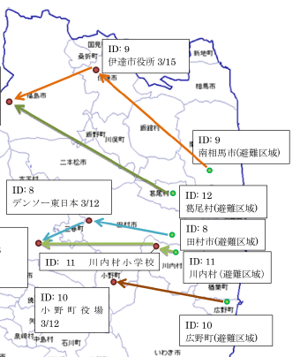
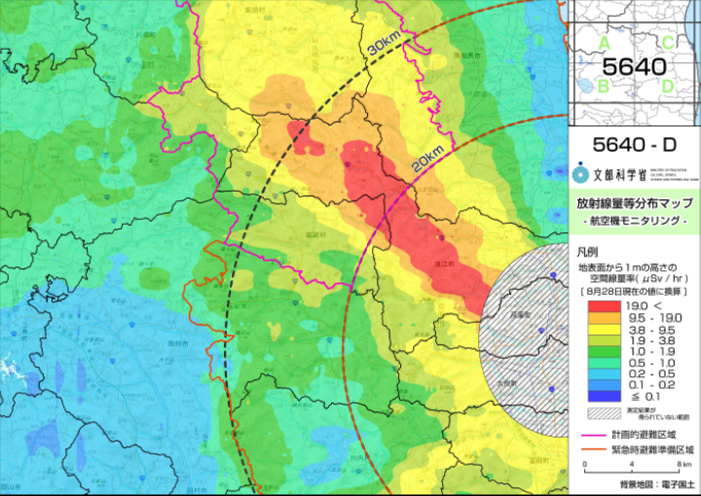
Background
- Gamma ray dose rate is considerably different from place to place
- Evacuees moved from their original places
- Various evacuation patterns
“Record of movement” for each resident is necessary to estimate realistic external dose
10 km
0.1 to >19 μSv/h
Five examples of evacuation patterns
10 km
Example of gamma ray dose rate map after the accident (MEXT website)
MEXT: Ministry of Education, Culture, Sports, Science and Technology
Eastern part of
Fukushima Pref.

Slide 3
Background
Many dose estimation studies have been done after the accident
In some cases, dose estimation is based on conservative assumptions to avoid underestimation
Ex. People stay outdoor all day long
a kind of “projected dose” (see below)
More realistic dose based on actual situations
Basic Survey
Projected dose:
The dose that would be received if no countermeasures were to be taken
(IAEA Basic Safety Standard, 1996)
Similar definition in ICRP Publication 63.

Slide 4
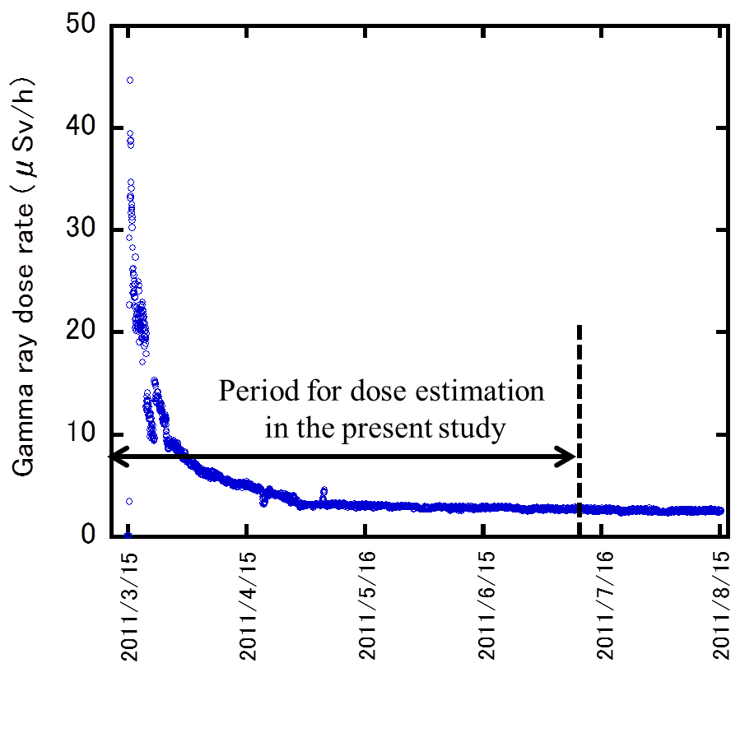
Outline of Basic Survey
Fukushima Health Management Survey
・Basic Survey
・Four detailed Surveys
Questionnaire targeting roughly 2,050,000 people who were living, or were present, in Fukushima Prefecture as of March 11, 2011.
Items:
Whereabouts for each day in the period
（locations and Indoor, outdoor, or moving）
Period: March 11, 2011 – July 11, 2011
Period for dose
estimation
Mar 15
Apr 15
May 15
Jun 15
Jul 15
Aug 15
Changes in gamma ray dose rate in Iitate Village:
After four months, gamma ray dose rate seems to be plateau

Slide 5
Questionnaire of Basic Survey
Sample of response sheet
Children under 20y: signatures by their parents are necessary

Slide 6
Dose calculation (check of response sheets)
Checking response sheets returned from the residents
Contact each respondent to completely fill in the response sheet (by telephone or mail,
more than 70,000 respondents)
The response sheet is sufficient ?
(any blank items?)
Records of the movement of respondents are digitized
Sending the records to NIRS
NIRS: National Institute of Radiological Sciences, Chiba, Japan

Slide 7
NIRS dose calculation program
Monitoring data obtained
by MEXT
Records of the movement
(digitized questionnaire)
- Moving, outdoor, indoor
- Hours spent in the region
- Hours of moving
- Location of the region
- Dose reduction factor for
each type of dwellings
Subtracting dose due to natural radiation
Conversion to effective dose
Construction of daily
dose rate maps
Akahane et al: Scientific Report
3: 1670 (2013)
Calculation of effective dose for adult
Body size (age) correction
Effective dose for each respondent

Slide 8
How to report the results
Individual estimates of external dose
The individual doses are statistically processed at FMU
The results are discussed at Fukushima Prefectural Oversight Committee Meeting (once in about three months) http://www.fmu.ac.jp/radiationhealth/
FMU reports the individual external dose to each respondent by mail
Doses have been estimated for 470,234 / 515,212 respondents (91.3 %) as of 31 December 2013.

Slide 9
Results (whole prefecture)
Effective dose (mSv) | Number of respondents (excluding radiation workers) | Ratio
< 1 | 305,286 | 66.3 %
1 - 2 | 131,606 | 28.6 %
2 - 3 | 20,403 | 4.4 %
3 - 4 4 - 5 > 5 | 1,457 578 1078 | 0.3 % 0.1 % 0.2 %
Total | 460,408 | 100 %
Maximum: 25 mSv
Average: 0.8 mSv
(As of December 31, 2013)

Slide 10
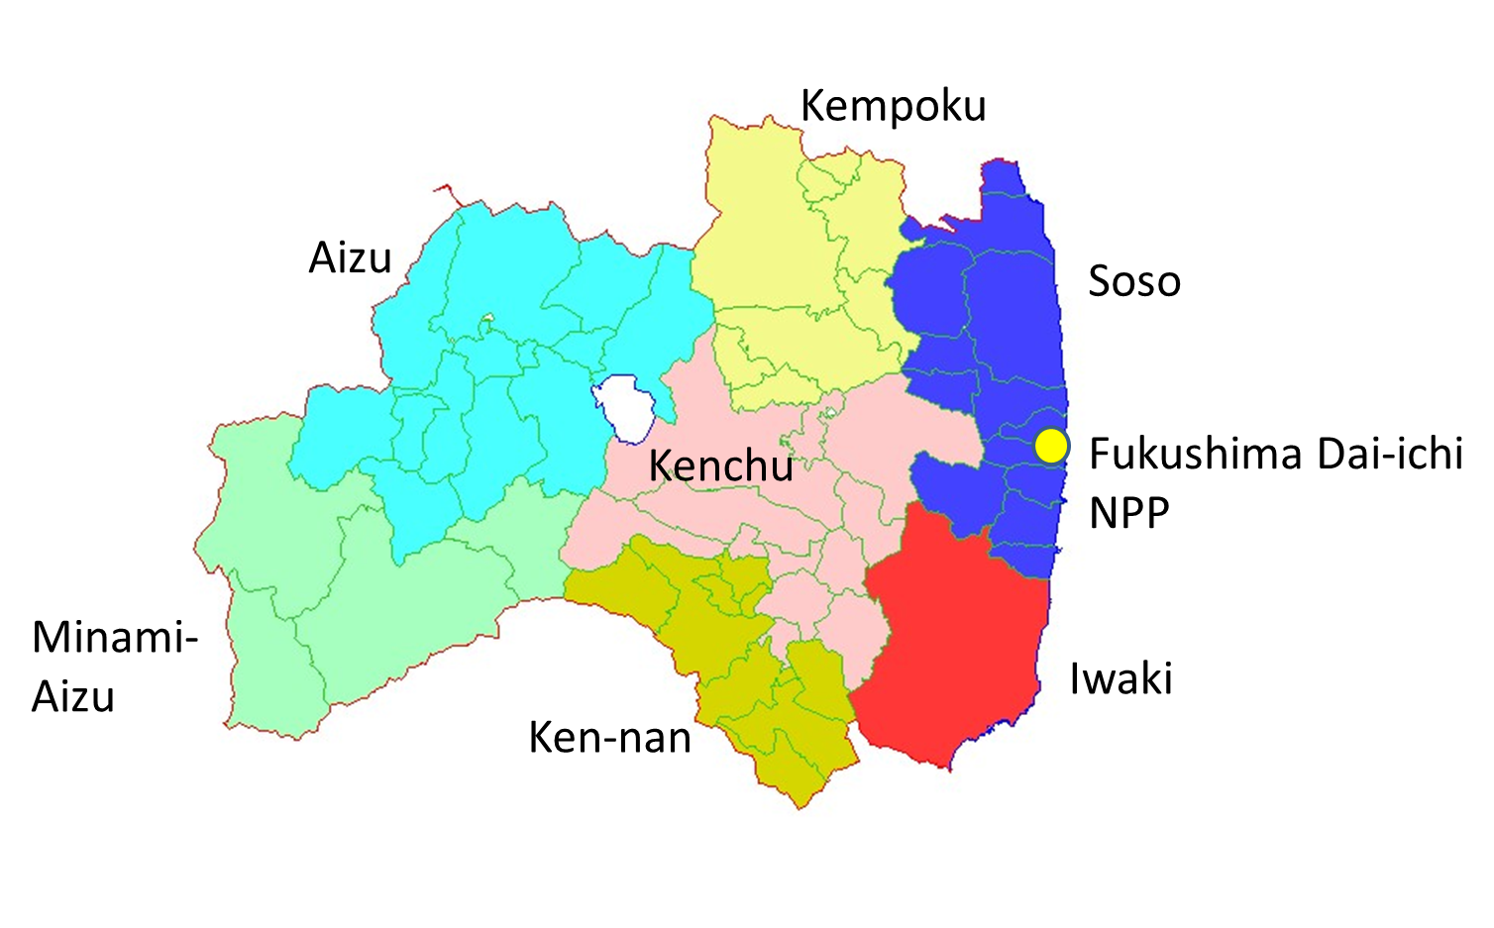
Results (dose distribution by regions)
< 1 mSv: 99.38 %
< 2 mSv: 99.98 %
Maximum: 3.6 mSv
Most of residents
evacuated
< 1 mSv: 78.0 %
< 2 mSv: 94.7 %
< 3 mSv: 97.2 %
Maximum: 25 mSv

Slide 11
Results (dose distribution: adults vs. children)
Dose distribution was almost similar between adults (≧20y) and children (＜ 20y).
The number ratio of doses of > 3 mSv was higher for adults.

Slide 12
Thyroid equivalent dose and effective dose
ISO irradiation geometry
(adopted in the NIRS dose calculation system)
Thyroid equivalent dose
≒ 1.1
Effective dose
(for gamma rays of 100-800 keV)
ICRP 74
Effective doses estimated by the Basic survey
Thyroid equivalent doses due to external
radiation during the corresponding period

Slide 13
Summary
External doses (for the first four months after the accident) have been estimated for more than 470,000 respondents by the Basic Survey.
The effective dose distribution (excluding radiation workers):
< 1 mSv, 66.3 %; <2 mSv, 94.9 %; <3 mSv, 99.3 %
According to ICRP 74, the ratio of thyroid equivalent dose to effective dose is around 1.1 in the case of isotropic irradiation geometry.
The effective dose values estimated in the Basic Survey could be similar to the thyroid equivalent doses due to external radiation during the first four months after the accident.

